Slide 1
Replication levels structure
Catchment
River1
River2
River3
The great majority of sites have only 1 spot (corresponding to specific coordinates of lat and long), as shown for site 3.
Number of years per site (or more correctly spot) can vary from 1 (often) to ca 15, most commonly 2. Number of sites per river are ca 1 to 5.
NB: There are NAs at the level of Site!
If I consider river as my replicate, shall I average away:
the spatial variation: take avg of sites per year, to obtain one value per river and year combination. This would solve the problem of having different spots per site and NAs in site’s labels (which could represent more than one site)
the temporal variation: calculate avg of years per each site. It would not solve the problem of NAs in site’s label, but lat-long show that NAs corrispond to one site most of the time rather than mutliple site, so as far as Site is nested in River (site/river) it can be okeysh.
Not to loose information and homogenize everything, I should average where the variability is lowest: from year to year or between sites of the same river? Test by plotting response variables (LWD and fish) vs site (boxplot) to see temporal variation, or vs river per year (xyplot) to see spatial variation between sites of the same river.
Site1
NA
Site3
n=1,2,3..5
Lat_long1
Lat_long2
n=1,2,3
Lat_long1
year1
year2
n=1,2,3…15
year1

Slide 2
Catchment
River1
River2
River3
Site1
Site2
Site3
n=1,2,3..5
Problem: some rivers belong to more than 1 catchment: why? How many?
Lat_long1
Lat_long2
n=1,2,3
Lat_long1
AVGyear1
AVGyear2
n=1,2,3…15
AVGyear1

Slide 3
Catchment
River1
River2
River3
AVG_Site1
AVG_NA
AVG_Site3
n=1,2,3..5
Lat_long1
Lat_long2
n=1,2,3
Lat_long1
year1
year2
n=1,2,3…15
year1

Slide 4
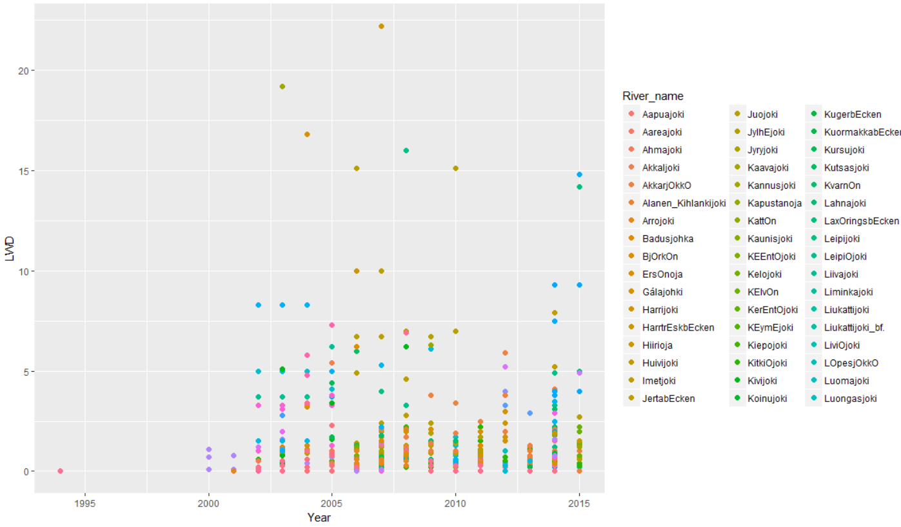
SPATIAL VARIATION within river and year, n=500
Y = LWD, fish abundance (by spp)
different sites of the same river sampled in the same year

Slide 5
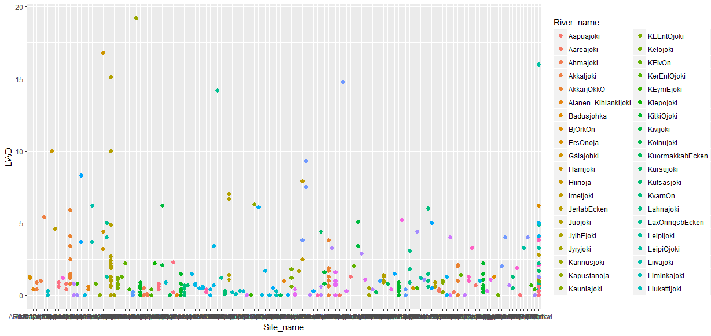
TEMPORAL VARIATION within site, n=400
Y = LWD, fish abundance (by spp)
Different years of the same site
Temporal variation looks larger, plus it may be good to retain temporal info (years) to be able to 1) look at changes over time, and 2) relate them to specific events
Extract averages per river and year

Slide 6
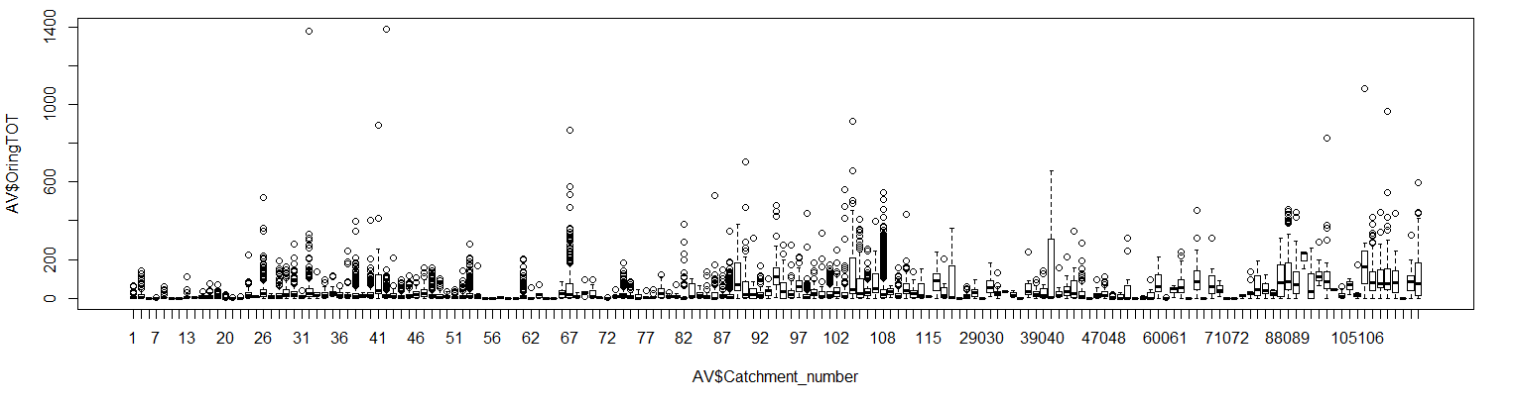
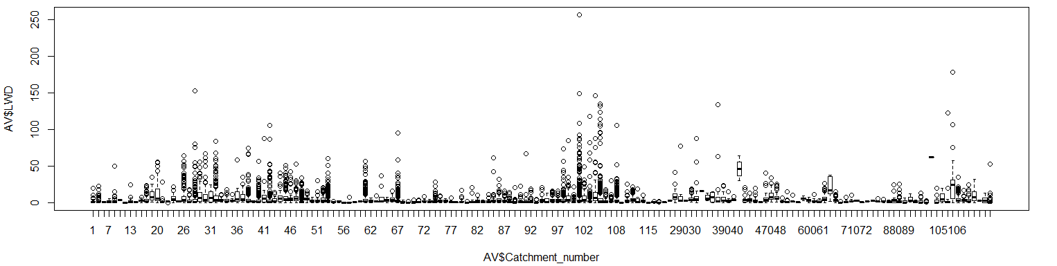
SPATIAL AUTOCORRELATION
1) Visual check (variation within vs between catchments)
Notes:
Check if boxes are horizontally aligned = small variation between catchments.
If they are very shifted = large variation between catchments.
Vertical dimension gives the variation within each catment
Was this fig madew ith means of sites per river?

Slide 7
2) Quick modeling also indicates correlation within cacthments:
M1<-lme(OringTOT~LWD, random =~1|Catchment_number, data=AV)
summary(M1)
M2<-lm(OringTOT~LWD, data=AV)
anova(M1,M2)
Notes:
But need to check:
lm vs glm, vs gam
consider other response variables, likely binary responses
try to model it together with the temporal correlation

Slide 8
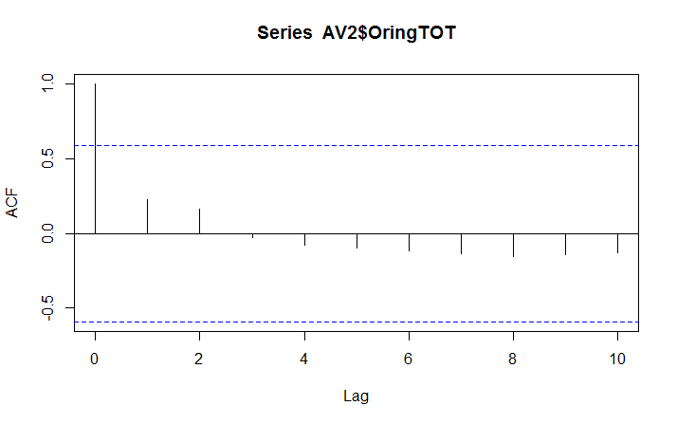
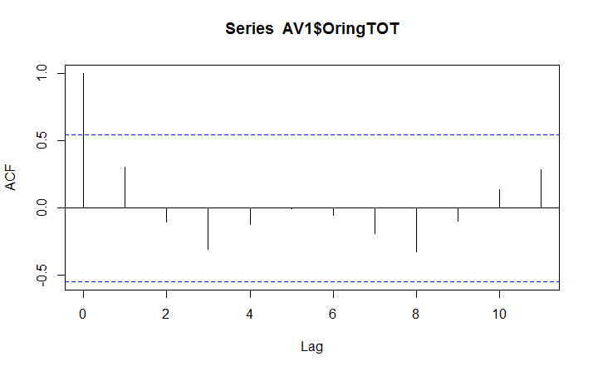
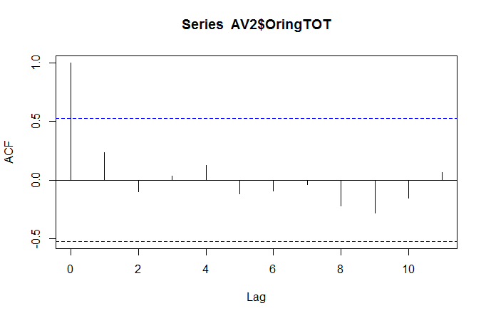
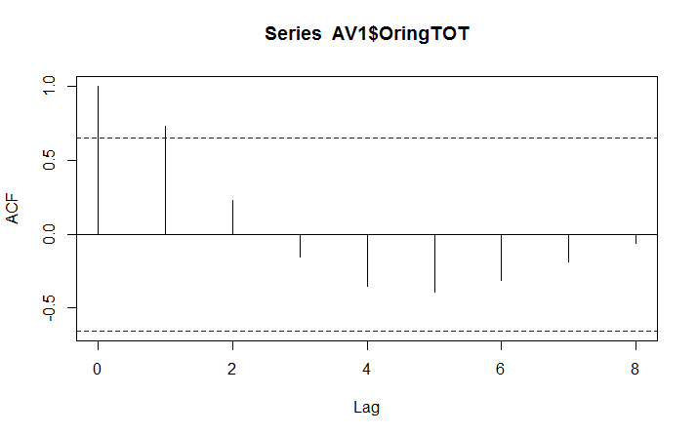
TEMPORAL AUTOCORRELATION
1) Visual check (i.e. rivers with longer time series, y = brown trouts)
weak
River: Svartön
River: Kitkiöjoki
Small, for lag=1y
River: Malbäcken
River: Akkarjökkö

Slide 9
2) Quick modeling also indicates correlation within catchments:
M0<-gls(OringTOT~LWD, data=AV)
M2<-gls(OringTOT~LWD, corCompSymm(form=~Year|River_name/Catchment_number), data=AV) # rho=0.591894
M3<-gls(OringTOT~LWD, corAR1(form=~Year|River_name/Catchment_number), data=AV) # phi = 0.69
M1<-gls(OringTOT~LWD, corLin(form=~Year|River_name/Catchment_number, nugget=T),data=AV)
AIC(M1,M2,M3,M0)
anova(M0,M1)
Notes:
the same river can belong to differnet cathment, that’s why we have nesting
Ideally I want to have both temporal and spatial correlation but it didn´t work so far

Slide 10
I should include both spatial and temporal autocorrelation.
In Peter’s dam removal study, I used this script:
# temporal corr signif?
model1<-lme(lnR~Time..months. +Catchment...undisturbed + Discharge..m3.s. , random=~1|DAM.CODE, data=reservoir)
model2<-lme(lnR~Time..months. +Catchment...undisturbed + Discharge..m3.s. , random=~1|DAM.CODE, data=reservoir, correlation=corExp(form=~Time..months.+DISTANCE+Initial.State))
anova(model1,model2) #nope
## NB: I included "initial state" in the correlation strc bc there are two points that were measured at the same
# distance and time, that's why R complained that there were zeros distances between points. What differentiate these
# points is the initial status, there were indeed points measured on both side of the lake.
Spatial and temporal correlation are modelled separately, i.e. I don’t need to include the spatial random factor in the temporal correlation structure. But in the temporal correlation I need to make sure that the values for which I model the temporal correlation come from the same spot, i.e. they can differ in year and river but not other spatial variables. E.g.:
M1<- lme(OringTOT~LWD, random=~1|River_name/Catchment_number, corCompSymm(form=~Year), data=AV
M1<- lme(OringTOT~LWD, random=~1|River_name/Catchment_number, correlation=corExp(form=~ Year), data=AV
M1<- lme(OringTOT~LWD, random=~1|River_name/Catchment_number, corAR1(form=~Year), data=AV
M1<- lme(OringTOT~LWD, random=~1|River_name/Catchment_number, corLin(form=~Year, data=AV
CorAR1 is the best (which is the same as corExp) and random factor is significant, at least for Öring, both continuous and categorical

Slide 11
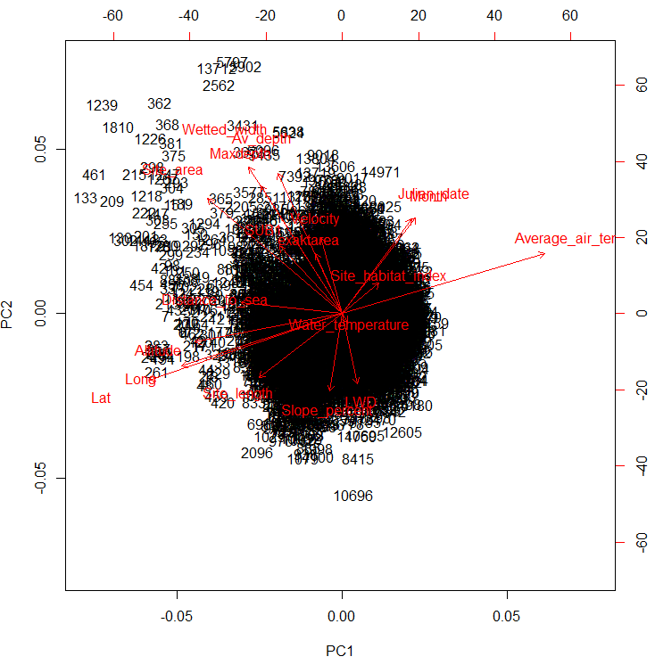
Collinearity among predictors:
DCA: DCA1 DCA2 DCA3 DCA4
Axis lengths 2.8568 1.74466 1.69388 1.10429
Gradient lengths were first estimated in a detrended
correspondence analysis (DCA). As the lengths of DCA axes 1
and 2 were both lower than 3, we used PCA, which assumes
linear responses of species to environmental gradients
(ter Braak and Smilauer 2002).
PCA: 21% by PC1, 14% by PC2
Correlated and contributing most to PC1 are:
-Climatic factors: Avg air temp ~~ lat and long ~ altitude
-Geographical factors: distance to sea
-Sampling factors: Site length (length walked), site area –
check sampling artifacts (y vs site length or area)
To PC2 are:
-Stream size: Avg depth ~wetted width ~ max depth~exact area
-Stream local features: velocity~ slope %, SUB1 or substrate1
-Wood: LWD
-Seasonality: Julian date ~month (between PC1 and PC2)
Extra factors to consider: Year (year-to-year variation), Water temp influences catchability. However, standard european: no sampling below 10 degrees. check its weight anyways. Maybe exclude samples taken at temp < 10 C?
PS: VIX or VIX_klass, and number of fish spp should be response rather than predictors?
NB: after removing NAs from matrix of 16.000 rows I end up with 5400 :/

Slide 12
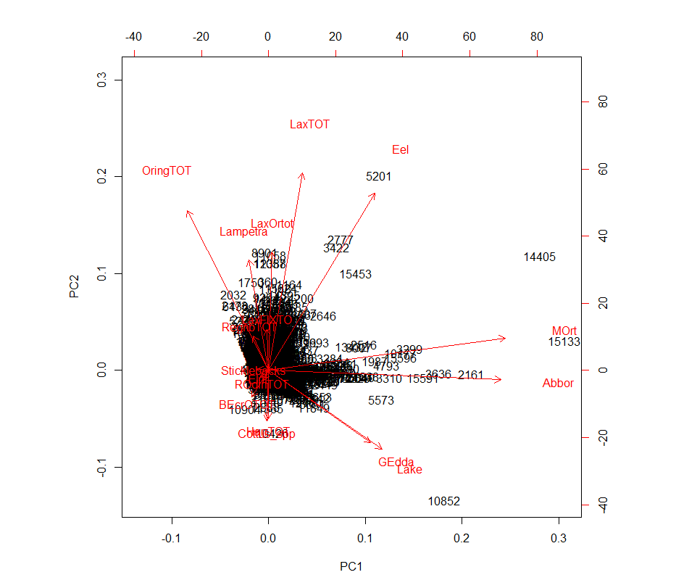
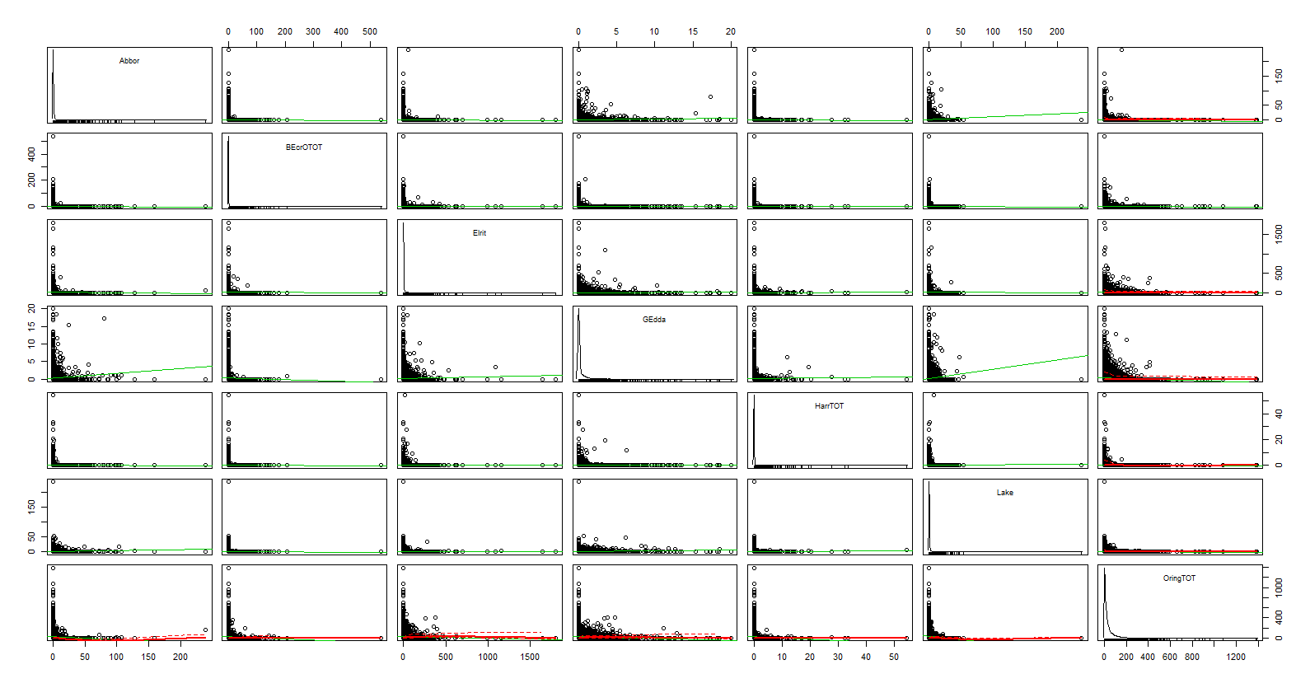
PCA on fish spp only

Slide 13
Response variables:
Individual species abundances: binary or continuous?
Number of fish species
Tot fish abundance
Biomass – but we don’t have lengths right? I think we do actually
Species composition (multivariate response)

Slide 14
Land use (land clearing, forestry and agriculture)
input of sediment, nutrients, OM
Hypotheses:
Sampling artifacts
(site length, site area, water temp)
Seasonality
(Julian date ~month)
Presence of dams, other obstacles, and bypasses
Precipitation, annual discharge
*distance to sea
Life history:
Type of migration
N. Fish spp
CLIMATE
(lat, altitude, avg air temp)
Geography
(distance to sea)
Large -scale
ÖRING
(abund or occurrence)
LWD
*stream width
Stream size
(Avg depth ~wetted width ~ max depth~exact area) *
Stream local features:
(velocity, slope %,
SUB1 or substrate1)
BIOTIC INTERACTIONS:
Predators and competitors
Tree spp.
LWD* Predators
Competitors*envir.conditions (slope/depth/temp/width)
N. of species
Latitude*pike
Year-to-year variation
(Year)
Small-scale
vegetation
Notes:
Woody debris can create pool therefore can potentially affect the depth and maybe the width (Dahlström and Nilsson 2004). Talk to Erik. Maybe wetted width is less liikely to be affected by LWD, if not, exact area should be indipendent. Test: wetted width (or exact area) -> LWD-> depth
LWD: test interaction with predtaors or abiotic such as wetted width (Erik’s graph suggests there may be an interaction)

Slide 15
Links supported by literature
Effects on fish:
Woody debris enhance trout abundance (Sievers et al. 2017, Degerman et al. 2004, Roni et al. 2008, 2015 and ref therein). Also, max lentgh increases while avg size of juv decreases due to density dependence (Degerman et al. 2004)
Wood debris may be especially important as shelter in presence of predators (e.g. pikes, burbots. Enefalk et al. 2016). But also: nesting and feeding ground (Dolloff and Warren 2003). three main functions: overhead cover that decreases predation risk both vertically and horizontally; horizontal visual isolation that reduces contact between fish; and velocity refuge which minimizes energetic costs. It may modify predator–prey interactions, and provides spatial reference points (Crooks and Robertson 1999).
Create pools and change morphology of the channel, thus affecting fish. Most positive responses reported were for juvenile and adult salmonids, with results for non-salmonid fishes being equivocal. (Roni et al. 2014 and ref therein, Langford et al. 2012)
Land use (land clearing, forestry and agriculture) influence trout abundance and size (Sievers et al. 2017)
Stream width affects fish abundance (positive response for trout Degerman et al. 2004, variable response for fish Trigal and Degerman 2015)
Connectivity: distance to sea or lakes (variable response, Trigal and Degerman 2015)
Water temperature, positive response (Trigal and Degerman 2015)
Temperature may also influence the outcome of interactions with competitors such as brook trout and brown trout and salmon (Ohlund et al 2008)
Water discharge, positive response (Trigal and Degerman 2015)
Substrate affects fish abundance (Trigal and Degerman 2015)
Type of migration: Allopatric brown trout shift from nursery area in riffles to pool habitat while simpatric (under prerssure from other spp) remain in the riffle (Näslund et al. 1997).
Frequency of occurrence and abundances of brown trout correlate negatively with number of coexisisting fish species (Näslund et al. 1997)
The effects of depth and slope may be conditional to the presence of competitors, i.e. Habitat partitioning when trout occur in simpatry with graylings (Degermann et al. 2000)
Temperature and stream width may also influence the outcome of interactions with competitors such as brook trout and brown trout and salmon (Ohlund et al 2008)
Effects on LWD:
Channel slope, channel size, tree species (affecting decay rate, Roni et al. 2014)
LWD affect stream functions:
Obs: Potential feedbacks? Wood creates pool, increases retention of OM and nutrients, affect bed load transport and sediment at the bottom, increases availability of spawning area, increases periphyton and invertebrate production, improves habitat complexity (Roni et al. 2014)
Check also: Friberg et al., and Harmon et al. 1986

Slide 16
CONTINUOUS
Best models are listed first
I would consider fish spp as continuous rather than binary, for the sake of consistency with öring , which gives better fit if continuous. Decide on wheter to consider them as endogenous or exogenous

Slide 17
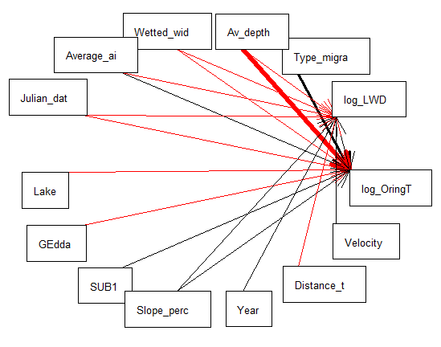
TROUT
> M2 = list(
+ lme(log_OringTOT~Average_air_temperature+Wetted_width+Av_depth+log_LWD+SUB1+Julian_date+Slope_percent
+ +GEdda+Lake+Type_migration_continuous,
+ random=~1|River_name/Catchment_number, corAR1(form=~Year),data=AV_Migration_NAremoved2),
+ lme(log_LWD~Average_air_temperature+Distance_to_sea+Av_depth+Wetted_width+Year+Julian_date+Slope_percent+Velocity,
+ random=~1|River_name/Catchment_number, corAR1(form=~Year),data=AV_Migration_NAremoved2))
> sem.fit(M2,AV_Migration_NAremoved2)
$missing.paths
missing.path estimate std.error df crit.value p.value
1 log_LWD ~ SUB1 + ... -0.0067 0.0140 3890 -0.4820 0.6299
2 log_LWD ~ GEdda + ... -0.0131 0.0111 3890 -1.1823 0.2371
3 log_LWD ~ Lake + ... -0.0053 0.0062 3890 -0.8543 0.3930
4 log_LWD ~ Type_migration_continuous + ... -0.0383 0.0412 3890 -0.9293 0.3528
5 log_OringTOT ~ Distance_to_sea + ... -0.0010 0.0007 3888 -1.4408 0.1497
6 log_OringTOT ~ Year + ... 0.0017 0.0028 3888 0.5926 0.5535
7 log_OringTOT ~ Velocity + ... 0.0265 0.0309 3888 0.8580 0.3910
$Fisher.C
fisher.c df p.value
1 14.61 14 0.405
$AIC
AIC AICc K n
1 70.61 70.938 28 4976
> sem.coefs(M2,AV_Migration_NAremoved2)
response predictor estimate std.error p.value
1 log_OringTOT Type_migration_continuous 0.925768554 0.0639112156 0.0000 ***
2 log_OringTOT Av_depth -1.986194814 0.1590231932 0.0000 ***
3 log_OringTOT Wetted_width -0.088741061 0.0078044025 0.0000 ***
4 log_OringTOT Average_air_temperature 0.129761655 0.0190612990 0.0000 ***
5 log_OringTOT Julian_date -0.004368678 0.0006652003 0.0000 ***
6 log_OringTOT log_LWD 0.104542928 0.0198940773 0.0000 ***
7 log_OringTOT Lake -0.047780255 0.0093267824 0.0000 ***
8 log_OringTOT GEdda -0.074514694 0.0169036372 0.0000 ***
9 log_OringTOT SUB1 0.089713382 0.0203741279 0.0000 ***
10 log_OringTOT Slope_percent 0.053298205 0.0200843194 0.0080 **
11 log_LWD Wetted_width -0.055671987 0.0048311321 0.0000 ***
12 log_LWD Average_air_temperature -0.081809923 0.0114651974 0.0000 ***
13 log_LWD Year 0.014648880 0.0025487481 0.0000 ***
14 log_LWD Slope_percent 0.064714714 0.0122277890 0.0000 ***
15 log_LWD Distance_to_sea -0.001887691 0.0003921625 0.0000 ***
16 log_LWD Av_depth -0.489764912 0.1098665964 0.0000 ***
17 log_LWD Velocity 0.084106179 0.0210048993 0.0001 ***
18 log_LWD Julian_date -0.001033654 0.0004530429 0.0226 *
> sem.model.fits(M2)
Class Family Link n Marginal Conditional
1 lme gaussian identity 4976 0.207544 0.7849169
2 lme gaussian identity 4976 0.118362 0.5201738
> sem.coefs(M2,AV2,standardize = "scale")
response predictor estimate std.error p.value
1 log_OringTOT Av_depth -0.12937341 0.010081272 0.0000 ***
2 log_OringTOT Type_migration_continuous 0.25887977 0.020721348 0.0000 ***
3 log_OringTOT Wetted_width -0.19286715 0.018390268 0.0000 ***
4 log_OringTOT Average_air_temperature 0.18635662 0.025847227 0.0000 ***
5 log_OringTOT Julian_date -0.06083182 0.010758908 0.0000 ***
6 log_OringTOT Lake -0.04567463 0.009591012 0.0000 ***
7 log_OringTOT SUB1 0.05353736 0.012721049 0.0000 ***
8 log_OringTOT log_LWD 0.05023221 0.012296291 0.0000 ***
9 log_OringTOT GEdda -0.02809371 0.007949563 0.0004 ***
10 log_OringTOT Slope_percent 0.06310003 0.020482661 0.0021 **
11 log_LWD Wetted_width -0.19913884 0.020347519 0.0000 ***
12 log_LWD Slope_percent 0.11935981 0.021875047 0.0000 ***
13 log_LWD Average_air_temperature -0.14243106 0.028129478 0.0000 ***
14 log_LWD Av_depth -0.05980280 0.012136992 0.0000 ***
15 log_LWD Year 0.07718745 0.016907269 0.0000 ***
16 log_LWD Velocity 0.05402872 0.012185757 0.0000 ***
17 log_LWD Distance_to_sea -0.08623132 0.025205183 0.0006 ***
18 log_LWD Julian_date -0.01126001 0.012792280 0.3788
Warning messages:
> sem.coefs(M2,AV2,standardize = "range")
response predictor estimate std.error p.value
1 log_OringTOT Av_depth -0.22722276 0.01780044 0.0000 ***
2 log_OringTOT Type_migration_continuous 0.12035257 0.01009357 0.0000 ***
3 log_OringTOT Wetted_width -0.41798048 0.04110555 0.0000 ***
4 log_OringTOT Average_air_temperature 0.22884690 0.02964291 0.0000 ***
5 log_OringTOT Julian_date -0.07263637 0.01170509 0.0000 ***
6 log_OringTOT Lake -0.22016268 0.04973866 0.0000 ***
7 log_OringTOT log_LWD 0.06300440 0.01637103 0.0001 ***
8 log_OringTOT SUB1 0.04864224 0.01476735 0.0010 ***
9 log_OringTOT Slope_percent 0.11274405 0.03597125 0.0017 **
10 log_OringTOT GEdda -0.08808913 0.02999541 0.0033 **
11 log_LWD Wetted_width -0.32462200 0.03481897 0.0000 ***
12 log_LWD Slope_percent 0.14725222 0.02959564 0.0000 ***
13 log_LWD Av_depth -0.07323760 0.01613162 0.0000 ***
14 log_LWD Average_air_temperature -0.11160331 0.02530381 0.0000 ***
15 log_LWD Year 0.05189406 0.01270568 0.0000 ***
16 log_LWD Velocity 0.03076672 0.00769362 0.0001 ***
17 log_LWD Distance_to_sea -0.08252521 0.03143208 0.0087 **
18 log_LWD Julian_date -0.00614861 0.01045441 0.5565

Slide 18
Removing NAs at site level for ”Type of migration” (Then calculate averages per river and year and remove NAs from it)
a)migration type: signif (positive, quite strong). Dist to sea is not signif anymore.
Explained variance: 21% and 12%
b) Number of spp could determine whether trout migrate or not (not if many fish), which in turn affects öring. N. of spp could therefore have a direct effect on öring (e.g. reduced growth, and maybe spawning output), or indirect effect (reduced local population size). Also, depth or width may affect type of migration. But using type of migration as endogenous results in a very complicated model that most of the time does not converge.
(the interaction betweeen depth or width and type of migration affect öring is signif (negative). dist to sea and year not signif for öring but necessary for good model fit# deleting link but using correlation.Explained variance: 21-22% and 12%. But maybe not correct to test interaction)
With the same model (a) with predators (lake and gädda), and the competitor brook trout as binary: no biotic interaction is signif, it is same model as above (in a) but without predators.
If I test separate models, one for migrating one for not, explained variance is much lower: ca. 0.10 for trouts
# adding velocity:signif only for LWD not trout
# the link julian date-LWD is signif only with unstardidized coeff. Therefore I won't try interaction date*depth/width/lat/altitude
# # 2) substitute altitude to dist to the sea: as dist to the sea, not signif on trout but signif on LWD.
# explained variance is 21% and 11% (before it was 21 and 12). as before, the link julian date-LWD is signif only with unstardidized coeff
It is kind of the same, decide based on interpreattoion and on the predictors used for salmon (and cottus) whether you want to inlcude altitude or distance to sea

Slide 19
Large –scale factors
Temporal variability
TROUT
Avg air temp (or Latitude)
Julian date
DA RICONTROLLARE
Type of migration
distance to sea
ÖRING
(abundance)
LWD
wetted width
Burbot
Avg depth
Slope
Pike
Year
Substrate
Small-scale factors
Biotic interactions
Notes:
Thickness of arrow is proportional at coefficient standardized on ranges. Coeff for julian dtae is signif when unstardidized but not when standardized.
Woody debris can create pool therefore can potentially affect the depth and maybe the width (Dahlström and Nilsson 2004). Talk to Erik. Maybe wetted width is less likely to be affected by LWD, if not, exact area should be indipendent. Test: wetted width (or exact area) -> LWD-> depth. However no problem: Link between LWD and depth is negative, so the causal relationship should go from depth to LWD
LWD: test interaction with predtaors or abiotic such as wetted width (Erik’s graph suggests there may be an interaction: LWD increase öring abundance when stream width is higher of a certain threshold): not signif
M2 = list(
lme(log_OringTOT~Average_air_temperature+Wetted_width+Av_depth+log_LWD+SUB1+Julian_date+
Slope_percent +GEdda+Lake+Type_migration_continuous,
random=~1|River_name/Catchment_number, corAR1(form=~Year),data=AV_Migration_NAremoved2),
lme(log_LWD~Average_air_temperature+Distance_to_sea+Av_depth+Wetted_width+Year+Julian_date+Slope_percent,
random=~1|River_name/Catchment_number, corAR1(form=~Year),data=AV_Migration_NAremoved2))
sem.fit(M2,AV_Migration_NAremoved2)

Slide 20
# Overview of predictors and interactions considered:
# 1)Climatic factors: avg air temp OR lat are the best
# 3)Stream size: exact area is signif?NO. better avg or max depth
# 4) inlcude all local features: velocity for LWD:no. Slope_percent for both LWD and Öring (+)
#5) add month or julian date:
# 6) biotic interactions: potential predatrors are GEdda and Lake. Potential competitors are: LaxTOT, Becro, Harr, Cottus_spp
# include VIX? not for now, preliminary results not promising (see below)
Outcome with predators and competitors:
# brook trout (becro) and grayling (Harr) as explanatory factors: not signif
# LAxTOT or Cottus seems to have a weak positive effect on Öring, which does not make sense
# interaction between predators (Gädda or lake) and LWD (on öring): not significant
# test interaction between air temperature or latitude (instället air temp) and pike on öring: both not signif
# interaction between competitors (LaxTOT,BEcrOTOT, HarrTOT,Cottus_spp) and environmental conditions
# (slope, depth, width, temp): none of the possible conbination is signif
# test effects of number fish spp on öring: signif but has a positive effects! Skip it?
Others:
# interaction between stream width and LWD (on öring): not significant
# are there abiotics that can potentially be influenced by LWD? depth or width (LWD can create pools), but link is negative,
# so causal link has to go from depth to LWD
# interaction Julian date*distance to sea on LWD and on öring: nope
# including a correlation between SUB1 and slope doesn't change anything
# including SUB as endogenous explained by slope doesn't work smoothly, I d need to add many other links
# mygration type: include as continuous!

Slide 21
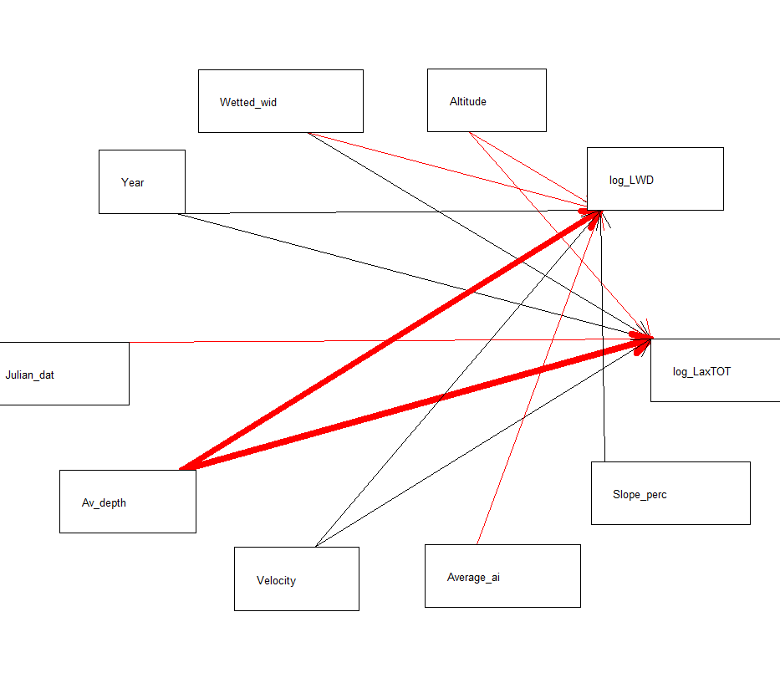
SALMON
> M2 = list(
+ lme(log_LaxTOT~Av_depth+Wetted_width+Julian_date+Altitude+Year+Velocity,
+ random=~1|River_name/Catchment_number, corAR1(form=~Year),data=AV2),
+ lme(log_LWD~Average_air_temperature+Av_depth+Wetted_width+Year+Slope_percent+Velocity+Altitude,
+ random=~1|River_name/Catchment_number, corAR1(form=~Year),data=AV2))
> sem.fit(M2,AV2)
Conditional variables have been omitted from output table for clarity (or use argument conditional = T)
$missing.paths
missing.path estimate std.error df crit.value p.value
1 log_LWD ~ Julian_date + ... -0.0008 0.0005 3671 -1.7112 0.0871
2 log_LaxTOT ~ Average_air_temperature + ... 0.0025 0.0157 3672 0.1625 0.8709
3 log_LaxTOT ~ Slope_percent + ... -0.0112 0.0142 3672 -0.7937 0.4274
4 log_LWD ~ log_LaxTOT + ... 0.0119 0.0140 3670 0.8477 0.3967
$Fisher.C
fisher.c df p.value
1 8.71 8 0.368
$AIC
AIC AICc K n
1 54.71 54.944 23 4735
> sem.coefs(M2,AV2)
response predictor estimate std.error p.value
1 log_LaxTOT Altitude -0.002996435 0.0003445745 0.0000 ***
2 log_LaxTOT Wetted_width 0.042812448 0.0053237328 0.0000 ***
3 log_LaxTOT Year 0.012316834 0.0023098464 0.0000 ***
4 log_LaxTOT Julian_date -0.002536128 0.0004773303 0.0000 ***
5 log_LaxTOT Av_depth -0.555995337 0.1137149045 0.0000 ***
6 log_LaxTOT Velocity 0.104848806 0.0217316701 0.0000 ***
7 log_LWD Wetted_width -0.055695457 0.0050173308 0.0000 ***
8 log_LWD Average_air_temperature -0.086982710 0.0131460606 0.0000 ***
9 log_LWD Slope_percent 0.071570204 0.0126143871 0.0000 ***
10 log_LWD Year 0.014449670 0.0026349692 0.0000 ***
11 log_LWD Av_depth -0.513321532 0.1129704364 0.0000 ***
12 log_LWD Velocity 0.086346728 0.0216795889 0.0001 ***
13 log_LWD Altitude -0.001155845 0.0003556516 0.0012 **
> sem.model.fits(M2)
Class Family Link n Marginal Conditional
1 lme gaussian identity 4735 0.06361988 0.6953213
2 lme gaussian identity 4735 0.10462220 0.5115992
sem.plot(M2, AV2)
> sem.coefs(M2,AV2,standardize = "scale")
response predictor estimate std.error p.value
1 log_LaxTOT Altitude -0.15322615 0.017780872 0.0000 ***
2 log_LaxTOT Wetted_width 0.12363645 0.014679891 0.0000 ***
3 log_LaxTOT Av_depth -0.05049793 0.008631317 0.0000 ***
4 log_LaxTOT Velocity 0.03504619 0.008692399 0.0001 ***
5 log_LaxTOT Julian_date -0.03603670 0.009195188 0.0001 ***
6 log_LaxTOT Year 0.03327763 0.012744974 0.0091 **
7 log_LWD Wetted_width -0.20370480 0.020415018 0.0000 ***
8 log_LWD Slope_percent 0.12510530 0.021820934 0.0000 ***
9 log_LWD Av_depth -0.06153908 0.012099736 0.0000 ***
10 log_LWD Average_air_temperature -0.15468251 0.031252206 0.0000 ***
11 log_LWD Year 0.07597864 0.016943423 0.0000 ***
12 log_LWD Velocity 0.05381512 0.012171210 0.0000 ***
13 log_LWD Altitude -0.07485606 0.027733830 0.0070 **
scale on range gives problem with temp correlation. If I delete it: it works:
> sem.coefs(M2,AV2,standardize = "range")
response predictor estimate std.error p.value
1 log_LaxTOT Altitude -0.27366034 0.030148310 0e+00 ***
2 log_LaxTOT Wetted_width 0.29507039 0.034114389 0e+00 ***
3 log_LaxTOT Year 0.03828807 0.006283535 0e+00 ***
4 log_LaxTOT Julian_date -0.05843799 0.010520580 0e+00 ***
5 log_LaxTOT Velocity 0.03969632 0.007701014 0e+00 ***
6 log_LaxTOT Av_depth -0.06774507 0.016187382 0e+00 ***
7 log_LWD Wetted_width -0.36824728 0.033893320 0e+00 ***
8 log_LWD Average_air_temperature -0.16316211 0.023668986 0e+00 ***
9 log_LWD Year 0.03658300 0.006840838 0e+00 ***
10 log_LWD Av_depth -0.09266925 0.017423179 0e+00 ***
11 log_LWD Slope_percent 0.14025166 0.026535794 0e+00 ***
12 log_LWD Velocity 0.04181156 0.008267196 0e+00 ***
13 log_LWD Altitude -0.11407767 0.032215075 4e-04 ***
Warning messages:
1: In if (grepl("cbind", deparse(formula(x)))) all.vars(formula(x))[-c(1:2)] else all.vars(formula(x)) :
the condition has length > 1 and only the first element will be used
2: In if (grepl("cbind", deparse(formula(x)))) all.vars(formula(x))[-c(1:2)] else all.vars(formula(x)) :
the condition has length > 1 and only the first element will be used
>
NB: working on AV2 – no need to remove Nas for mygration type as it is not included for salmon

Slide 22
Large –scale factors
Temporal variability
SALMON
Avg air temp (or Latitude)
Julian date
Altitude
SALMON
(abundance)
LWD
wetted width
Avg depth
Burbot
Slope
Velocity
Pike
Year
Small-scale factors
Substrate
Biotic interactions
Notes:
Thickness of arrow is proportional at coefficient standardized on scales (on range problems). Coeff for year and for the interaction julian date* distance to sea are signif when unstardidized but not when standardized.
Arrows with different colors from trouts:
width has + effect on salmon

Slide 23
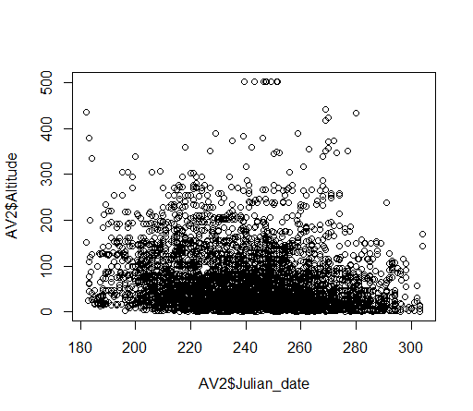
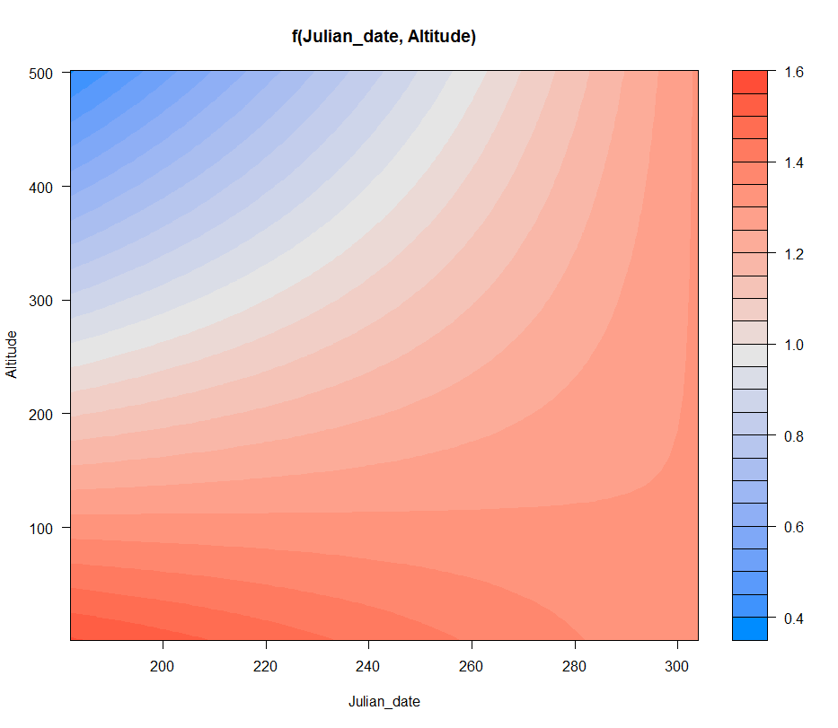
Update on salmon:
############# exclude type of migration - I use AV2 (NAs for migration type included) (the same model on AV_Migration_NAremoved2 does not improve explained variation)
# 1) if include velocity (vif with slope is fine): substrate is not signif for salmon but velocity is.
# And both velocity and slope affect (+) wood. explained variation does not change, but good for interpetation
# 2) if substitute altitude to dist to sea: air temp is not signif any more for salmon (ok!). and we get to 6%
# explained variation for salmon although 10 for LWD instead of 11. (with both altitude and dist to the sea: nope collinear with temperature and distance to sea)
NB: in this best model so far, the link date-to-LWD disppears, good!
# 3)interaction julian date and altitud (better than temp): explained variation: 7% and 11%but the model is
# completely identified so it does not work. Try again after including the type of forest. # best interpretation of interaction: wood decrease with altitudes and the negative effect of altitude on LWD weaken over the season,
# (and disappear later in the season, ca at the end of October - but there are few points at the extreme of the range
# so would not trust the graph too much). # weak negative correlation between altitude and julian date indicates that sites at higher altitude may have been sampled a bit earlier than sites at lower altitudes. which does not explain the negative main effect of julian date on wood. So the sampling is fine.
If you don’t include the interaction, to explain link between date and lwd remember that:
NOTE: averaging is not good when the relationship between variables is not linear or even monotonic. If I have a hump shaped curve, eg. between LWD and Julian date, this may not show up after taking averages of julian dates by river, e.g. in spring and autumn there may be low wood but if I take the average of the dates I get a value that correpsonds to summer! Which will be associated to low fish abundance!

Slide 24
Meeting March 16´th 2017 with Erik and Calle:
To do:
Try both slope and velocity. Signif! Include in the trout model as well!
Try interaction julian date*width/depth, or date*lat/altitude also for trout
Try to include altitude: nope collinear with temperature and distance to sea. or replace dist to sea with altitude. Also for trout.
Add data on forest cover and type
Look into standardized coefficients for trout and salmon: # scale on range gives problem with temp correlation. If I delete it: it works
Try model with Cottus
Comments:
What is new about our results: LWD does not help salmon population. Also, the predators of trout (Pike and burbot) do no affect salmon
Number of dams is unlikely to explain much according to Erik
Cottus does not have swim bladder, is not a good swimmer, can not travel far in the streams.
Electrofishing is not a good way to sample Lampetra
Skip site level model, no worth so far

Slide 25
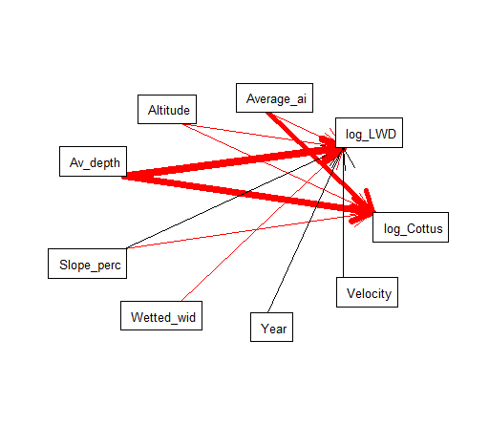
COTTUS
M2 = list(
+ lme(log_Cottus_spp~Average_air_temperature+Av_depth+Slope_percent+Altitude,
+ random=~1|River_name/Catchment_number, corAR1(form=~Year),data=AV2),
+ lme(log_LWD~Average_air_temperature+Altitude+Av_depth+Wetted_width+Year+Slope_percent+Velocity,
+ random=~1|River_name/Catchment_number, corAR1(form=~Year),data=AV2))
> sem.fit(M2,AV2)
|===============================================================================================================| 100%
Conditional variables have been omitted from output table for clarity (or use argument conditional = T)
$missing.paths
missing.path estimate std.error df crit.value p.value
1 log_Cottus_spp ~ Wetted_width + ... -0.0026 0.0054 3674 -0.4835 0.6287
2 log_Cottus_spp ~ Year + ... -0.0015 0.0022 3674 -0.6964 0.4862
3 log_Cottus_spp ~ Velocity + ... -0.0148 0.0200 3674 -0.7419 0.4582
4 log_LWD ~ log_Cottus_spp + ... 0.0125 0.0143 3671 0.8789 0.3795
$Fisher.C
fisher.c df p.value
1 5.87 8 0.662
$AIC
AIC AICc K n
1 47.87 48.066 21 4735
> sem.coefs(M2,AV2)
response predictor estimate std.error p.value
1 log_Cottus_spp Average_air_temperature -0.316310530 0.0175973698 0.0000 ***
2 log_Cottus_spp Altitude -0.003817689 0.0004473745 0.0000 ***
3 log_Cottus_spp Av_depth -0.444686981 0.1005167289 0.0000 ***
4 log_Cottus_spp Slope_percent -0.047617279 0.0147986197 0.0013 **
5 log_LWD Wetted_width -0.055695456 0.0050173308 0.0000 ***
6 log_LWD Average_air_temperature -0.086982710 0.0131460606 0.0000 ***
7 log_LWD Slope_percent 0.071570204 0.0126143871 0.0000 ***
8 log_LWD Year 0.014449670 0.0026349692 0.0000 ***
9 log_LWD Av_depth -0.513321533 0.1129704364 0.0000 ***
10 log_LWD Velocity 0.086346728 0.0216795889 0.0001 ***
11 log_LWD Altitude -0.001155845 0.0003556516 0.0012 **
> sem.model.fits(M2)
Class Family Link n Marginal Conditional
1 lme gaussian identity 4735 0.1856122 0.8248137
2 lme gaussian identity 4735 0.1046222 0.5115992
> sem.plot(M2, AV2)
> sem.coefs(M2,AV2,standardize = "scale")
response predictor estimate std.error p.value
1 log_Cottus_spp Average_air_temperature -0.46565630 0.027653620 0.0000 ***
2 log_Cottus_spp Altitude -0.18632469 0.022870976 0.0000 ***
3 log_Cottus_spp Av_depth -0.03565598 0.007120792 0.0000 ***
4 log_Cottus_spp Slope_percent -0.05346258 0.016875692 0.0015 **
5 log_LWD Wetted_width -0.20370479 0.020415019 0.0000 ***
6 log_LWD Slope_percent 0.12510529 0.021820934 0.0000 ***
7 log_LWD Av_depth -0.06153908 0.012099736 0.0000 ***
8 log_LWD Average_air_temperature -0.15468251 0.031252206 0.0000 ***
9 log_LWD Year 0.07597864 0.016943423 0.0000 ***
10 log_LWD Velocity 0.05381512 0.012171210 0.0000 ***
11 log_LWD Altitude -0.07485606 0.027733830 0.0070 **
Warning messages:
1: In if (grepl("cbind", deparse(formula(x)))) all.vars(formula(x))[-c(1:2)] else all.vars(formula(x)) :
the condition has length > 1 and only the first element will be used
2: In if (grepl("cbind", deparse(formula(x)))) all.vars(formula(x))[-c(1:2)] else all.vars(formula(x)) :
the condition has length > 1 and only the first element will be used
> sem.coefs(M2,AV2,standardize = "range")
response predictor estimate std.error p.value
1 log_Cottus_spp Average_air_temperature -0.43440257 0.026366871 0.0000 ***
2 log_Cottus_spp Altitude -0.24885920 0.032183753 0.0000 ***
3 log_Cottus_spp Av_depth -0.05520536 0.010458770 0.0000 ***
4 log_Cottus_spp Slope_percent -0.07881586 0.025089485 0.0017 **
5 log_LWD Wetted_width -0.33138088 0.034950319 0.0000 ***
6 log_LWD Slope_percent 0.15292036 0.029500607 0.0000 ***
7 log_LWD Av_depth -0.07504504 0.016083677 0.0000 ***
8 log_LWD Average_air_temperature -0.11872051 0.027900132 0.0000 ***
9 log_LWD Velocity 0.03096626 0.007686155 0.0001 ***
10 log_LWD Year 0.05026909 0.012744360 0.0001 ***
11 log_LWD Altitude -0.07617503 0.036302251 0.0359 *
+ link from lake to Cottus and from number of spieces are signif but don’t make sense
Notes:
No interaction temp*Gedda

Slide 27
USING FISH SPP AS ENDOGENOUS

Slide 28
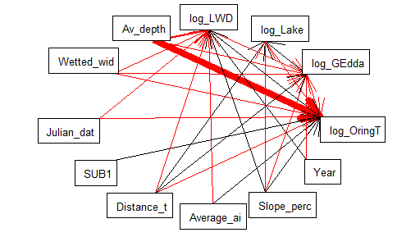
1c) FULL DATASET WITHOUT Nas (n=5263)
using fish spp (only predators: gedda and lake) as endogenous and continuous (logtranformed)
M2 = list(
+ lme(log_OringTOT~Average_air_temperature+Distance_to_sea+Wetted_width+Av_depth+log_LWD+SUB1+Julian_date+Slope_percent
+ +log_GEdda+log_Lake,
+ random=~1|River_name/Catchment_number, corAR1(form=~Year),data=AV2),
+ lme(log_GEdda~Distance_to_sea+Wetted_width+Av_depth+log_LWD+Year+Slope_percent,
+ random=~1|River_name/Catchment_number, corAR1(form=~Year),data=AV2),
+ lme(log_Lake~Distance_to_sea+Slope_percent+log_GEdda,
+ random=~1|River_name/Catchment_number, corAR1(form=~Year),data=AV2),
+ lme(log_LWD~Average_air_temperature+Distance_to_sea+Av_depth+Wetted_width+Year+Julian_date+Slope_percent,
+ random=~1|River_name/Catchment_number, corAR1(form=~Year),data=AV2))
> sem.fit(M2,AV2)
|===============================================================================================================| 100%
Conditional variables have been omitted from output table for clarity (or use argument conditional = T)
$missing.paths
missing.path estimate std.error df crit.value p.value
1 log_GEdda ~ Average_air_temperature + ... 0.0044 0.0040 4074 1.1095 0.2673
2 log_Lake ~ Average_air_temperature + ... 0.0026 0.0056 4077 0.4608 0.6450
3 log_Lake ~ Wetted_width + ... -0.0023 0.0023 4077 -0.9915 0.3215
4 log_Lake ~ Av_depth + ... -0.0647 0.0547 4077 -1.1827 0.2370
5 log_LWD ~ SUB1 + ... -0.0045 0.0132 4073 -0.3387 0.7349
6 log_GEdda ~ SUB1 + ... 0.0022 0.0058 4074 0.3752 0.7075
7 log_Lake ~ SUB1 + ... 0.0072 0.0068 4077 1.0640 0.2874
8 log_GEdda ~ Julian_date + ... -0.0001 0.0002 4074 -0.5474 0.5841
9 log_Lake ~ Julian_date + ... -0.0002 0.0002 4077 -0.9395 0.3476
10 log_OringTOT ~ Year + ... 0.0033 0.0028 4070 1.2041 0.2286
11 log_Lake ~ Year + ... -0.0013 0.0010 4077 -1.2143 0.2247
12 log_Lake ~ log_LWD + ... -0.0137 0.0071 4072 -1.9400 0.0524
$Fisher.C
fisher.c df p.value
1 27.49 24 0.282
$AIC
AIC AICc K n
1 119.49 120.319 46 5263
> sem.coefs(M2,AV2)
response predictor estimate std.error p.value
1 log_OringTOT Av_depth -2.1127094534 0.1556664803 0.0000 ***
2 log_OringTOT Wetted_width -0.0717638645 0.0077081856 0.0000 ***
3 log_OringTOT Julian_date -0.0041765234 0.0006588964 0.0000 ***
4 log_OringTOT SUB1 0.1013420518 0.0199174773 0.0000 ***
5 log_OringTOT Distance_to_sea -0.0031827950 0.0007008914 0.0000 ***
6 log_OringTOT log_GEdda -0.1805439906 0.0416166061 0.0000 ***
7 log_OringTOT log_LWD 0.0848236745 0.0195952491 0.0000 ***
8 log_OringTOT Average_air_temperature 0.0944772859 0.0218576548 0.0000 ***
9 log_OringTOT log_Lake -0.1653288126 0.0389314869 0.0000 ***
10 log_OringTOT Slope_percent 0.0521650291 0.0203726121 0.0105 *
11 log_GEdda Slope_percent -0.0268842547 0.0044747672 0.0000 ***
12 log_GEdda Wetted_width -0.0073105034 0.0018900515 0.0001 ***
13 log_GEdda Year -0.0032162675 0.0008859025 0.0003 ***
14 log_GEdda Av_depth -0.1497823703 0.0509724124 0.0033 **
15 log_GEdda log_LWD -0.0171429532 0.0060279674 0.0045 **
16 log_GEdda Distance_to_sea 0.0002575256 0.0001250118 0.0395 *
17 log_Lake log_GEdda 0.0725916367 0.0149322924 0.0000 ***
18 log_Lake Distance_to_sea 0.0007258939 0.0001749324 0.0000 ***
19 log_Lake Slope_percent -0.0194671832 0.0059609515 0.0011 **
20 log_LWD Wetted_width -0.0513064569 0.0045786817 0.0000 ***
21 log_LWD Average_air_temperature -0.0863970673 0.0109774258 0.0000 ***
22 log_LWD Year 0.0146906721 0.0024931123 0.0000 ***
23 log_LWD Distance_to_sea -0.0020112188 0.0003625159 0.0000 ***
24 log_LWD Slope_percent 0.0608121487 0.0115345003 0.0000 ***
25 log_LWD Av_depth -0.4858949689 0.1048185319 0.0000 ***
26 log_LWD Julian_date -0.0010543088 0.0004429863 0.0174 *
> sem.model.fits(M2)
Class Family Link n Marginal Conditional
1 lme gaussian identity 5263 0.11117753 0.7995193
2 lme gaussian identity 5263 0.02432406 0.3669207
3 lme gaussian identity 5263 0.01572498 0.5759497
4 lme gaussian identity 5263 0.11390240 0.5128521
> sem.plot(M2, AV2)
Without migrating type
Notes:
# adding competitors:
# interaction lax or harr or cottus with slope explaining öring: does not converge for Harr, not signif for lax and cottus

Slide 29
VIX index:
The nine environmental variables needed are catchment area (class 1 – 5) upstream of the sampling site (<10, <100, <1000, <10 000, and >10 000 km2), proportion of lake area (class 1 – 4 ) in the catchment upstream (<1, <5, <10 and >10 %), least distance (km) to the closest lake upstream or downstream the sampling site (up to 10 km), altitude (m) above sea level, slope measured by 1:50 000 maps (‰), yearly average air temperature (°C), July average air temperature, wetted width (m) of the stream, and sampled area (m2).
The borders for status classes of the index values are: class 1 (high status) ≥0.749, class 2 (good) ≥0.467, class 3 (moderate)
≥0.274, class 4 (poor) ≥0.081, and class 5 (bad) <0.081.
However, EFI estimated the status class higher compared to VIX approximately eight times more often than the reverse case. Especially small streams with sea migrating trout were estimated comparatively higher with EFI than with VIX.
# if I use VIX:
# 1)on the top of the factors that are already in the model: vix has positive link to öring, negative to gädda and lake,
# which are not affecting öring any longer, but they are still required in the model to have a Fisher C with p>0.05 (!)
# 2) but delete factors included in the estimation of VIX such as air temp, width, slope as explanatory for only fish or also for LWD, R2 for all except öring decrease a lot.
Maybe because the VIX is actually calculated with the öring abundances??? Linear regression looks like:
lm(formula = log_OringTOT ~ VIX, data = AV2)
Residuals:
Min 1Q Median 3Q Max
-4.3440 -1.0125 0.0402 0.9723 3.9733
Coefficients:
Estimate Std. Error t value Pr(>|t|)
(Intercept) 1.01246 0.04837 20.93 <2e-16 ***
VIX 4.27123 0.09348 45.69 <2e-16 ***
---
Residual standard error: 1.352 on 5261 degrees of freedom
Multiple R-squared: 0.2841, Adjusted R-squared: 0.284
F-statistic: 2088 on 1 and 5261 DF, p-value: < 2.2e-16
# compare with the simple mixed model öring vs VIX: check how to compare fit!
Using the same function from the piecewise package, a simple mixed-model gives a higher marginal R2 (0.15) compare to the SEM ( marginal R2= 0.11)

Slide 30
1d) FULL DATASET WITHOUT Nas (n=5263)
using fish spp (only predators: gedda and lake) as endogenous and binary
Oring is not affected by gedda and lake, but the opposite! Through a negative relationship – which can not be

Slide 31
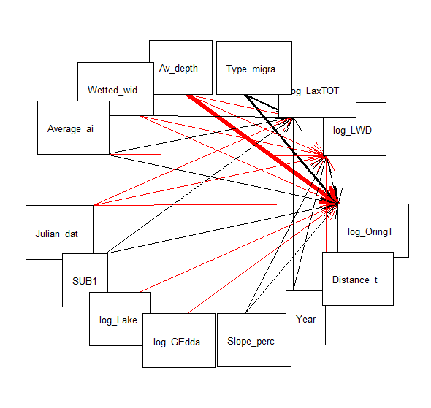
TROUT and SALMON
To reconsider with the last models
M2 = list(
lme(log_OringTOT~Average_air_temperature+Wetted_width+Av_depth+log_LWD+SUB1+Julian_date+Slope_percent
+log_GEdda+log_Lake+Type_migration_continuous,
random=~1|River_name/Catchment_number, corAR1(form=~Year),data=AV_Migration_NAremoved2),
lme(log_LWD~Average_air_temperature+Distance_to_sea+Av_depth+Wetted_width+Year+Julian_date+Slope_percent,
random=~1|River_name/Catchment_number, corAR1(form=~Year),data=AV_Migration_NAremoved2),
lme(log_LaxTOT~Average_air_temperature+Av_depth+Wetted_width+SUB1+Julian_date+Year
+Type_migration_continuous,
random=~1|River_name/Catchment_number, corAR1(form=~Year),data=AV_Migration_NAremoved2))
sem.fit(M2,AV_Migration_NAremoved2)
sem.fit(M2,AV_Migration_NAremoved2,corr.errors = c("GEdda~~log_LaxTOT",
"Lake~~log_LaxTOT","log_OringTOT~~log_LaxTOT" ))
> sem.model.fits(M2)
Class Family Link N Marginal Conditional
1 lme gaussian identity 4976 0.2099421 0.7837104
2 lme gaussian identity 4976 0.1165081 0.5212916
3 lme gaussian identity 4976 0.1166788 0.6864710
> sem.coefs(M2,AV_Migration_NAremoved2)
response predictor estimate std.error p.value
10 log_OringTOT Type_migration_continuous 0.9303504693 0.0638278313 0.0000
3 log_OringTOT Av_depth -1.9940688147 0.1593675774 0.0000
2 log_OringTOT Wetted_width -0.0884879824 0.0078038760 0.0000
1 log_OringTOT Average_air_temperature 0.1274179757 0.0190095300 0.0000
6 log_OringTOT Julian_date -0.0043669674 0.0006661024 0.0000
4 log_OringTOT log_LWD 0.1038938500 0.0199223867 0.0000
5 log_OringTOT SUB1 0.0897413038 0.0203916310 0.0000
9 log_OringTOT log_Lake -0.1757893690 0.0409918365 0.0000
8 log_OringTOT log_GEdda -0.1770802382 0.0420944168 0.0000
7 log_OringTOT Slope_percent 0.0516827108 0.0200777553 0.0101
14 log_LWD Wetted_width -0.0534539753 0.0048149057 0.0000
11 log_LWD Average_air_temperature -0.0823572305 0.0115259697 0.0000
17 log_LWD Slope_percent 0.0694740741 0.0122190308 0.0000
15 log_LWD Year 0.0144923198 0.0025569008 0.0000
12 log_LWD Distance_to_sea -0.0018303805 0.0003939320 0.0000
13 log_LWD Av_depth -0.4220141378 0.1086691382 0.0001
16 log_LWD Julian_date -0.0009598465 0.0004532223 0.0343
24 log_LaxTOT Type_migration_continuous 0.6088760161 0.0444380982 0.0000
20 log_LaxTOT Wetted_width 0.0441641044 0.0052548764 0.0000
23 log_LaxTOT Year 0.0115668468 0.0023080664 0.0000
22 log_LaxTOT Julian_date -0.0023412572 0.0004683927 0.0000
18 log_LaxTOT Average_air_temperature 0.0622694624 0.0125051899 0.0000
19 log_LaxTOT Av_depth -0.4018136269 0.1114183387 0.0003
21 log_LaxTOT SUB1 0.0394182640 0.0143162397 0.0059
>
Same output ca when Gädda and Lake are log transformed or not, the coeff obviously change slightly.
Deleting interaction distance to sea*Julian date. Not much of a difference, interaction is barely signif so I would skip it. With the intearction I need to model several correlated errors ("Slope_percent~~log_LaxTOT", "GEdda~~log_LaxTOT", "Lake~~log_LaxTOT" ))
Using velocity instead of slope: velocity is not signif for trout but signif and + for salmon and LWD. Explained variation decreases slightly for LWD
Notes:
Same output ca when Gädda and Lake are log tarsnformed
Adding slope as predictor for salmon and deleting interaction distance to sea*Julian date:

Slide 32
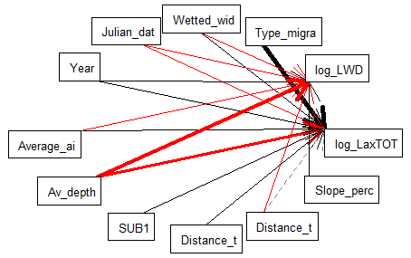
SALMON
OLD: Type of migration was still included
Using air temp or latitude doesn’t make much difference
Testing effects of predators or competitors (BEcrOTOT+ HarrTOT+ Cottus_spp+OringTOT): no main effects. No effects of interactions: Lwd*Gedda / lake, Air temp*Gedda, slope/depth/width/temp*OringTOT/BEcrOTOT. Using species as binary: BEcrOTOT_KLASS, Cottus_spp_KLASS,OringTOT_KLASs seem to have a + effect on salmon, does it make sense?
Number of fish spp: signif but positive. Include or skip? Skip for now.
Interaction LWD*width: nope
Interaction Julina date* distance to sea on Lax or LWD: signif on Lax, But barely
M2 = list(
lme(log_LaxTOT~Average_air_temperature+Av_depth+Wetted_width+SUB1+Distance_to_sea*Julian_date+Year
+Type_migration_continuous,
random=~1|River_name/Catchment_number, corAR1(form=~Year),data=AV_Migration_NAremoved2),
lme(log_LWD~Average_air_temperature+Distance_to_sea+Julian_date+Av_depth+Wetted_width+Year+Slope_percent,
random=~1|River_name/Catchment_number, corAR1(form=~Year),data=AV_Migration_NAremoved2))
sem.fit(M2,AV_Migration_NAremoved2)
sem.fit(M2,AV_Migration_NAremoved2,corr.errors = c("Slope_percent~~log_LaxTOT"))
sem.coefs(M2,AV_Migration_NAremoved2)
sem.model.fits(M2)
sem.plot(M2, AV_Migration_NAremoved2)
Explained variance: 12% and 12%
NB: LWD is not significant!
Notes:
Other:
# mygration type:

Slide 33
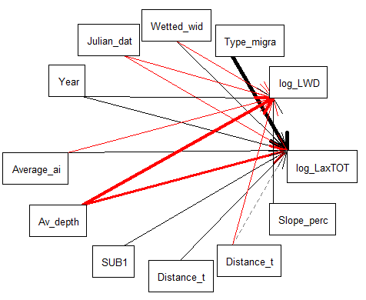
MODEL OUTPUT:
M2 = list(
+ lme(log_LaxTOT~Average_air_temperature+Av_depth+Wetted_width+SUB1+Distance_to_sea*Julian_date+Year
+ +Type_migration_continuous,
+ random=~1|River_name/Catchment_number, corAR1(form=~Year),data=AV_Migration_NAremoved2),
+ lme(log_LWD~Average_air_temperature+Distance_to_sea+Julian_date+Av_depth+Wetted_width+Year+Slope_percent,
+ random=~1|River_name/Catchment_number, corAR1(form=~Year),data=AV_Migration_NAremoved2))
> sem.fit(M2,AV_Migration_NAremoved2,corr.errors = c("Slope_percent~~log_LaxTOT"))
$missing.paths
missing.path estimate std.error df crit.value p.value
1 log_LWD ~ SUB1 + ... 0.0044 0.0138 3891 0.3163 0.7518
2 log_LWD ~ Type_migration_continuous + ... -0.0317 0.0414 3891 -0.7676 0.4428
3 log_LWD ~ Distance_to_sea*Julian_date + ... 0.0000 0.0000 3891 0.2332 0.8156
4 log_LWD ~ log_LaxTOT + ... 0.0000 0.0000 3888 0.1604 0.8726
$Fisher.C
fisher.c df p.value
1 2.88 8 0.942
$AIC
AIC AICc K n
1 54.88 55.164 26 4976
> sem.coefs(M2,AV_Migration_NAremoved2)
response predictor estimate std.error p.value
1 log_LaxTOT Type_migration_continuous 6.141295e-01 4.556165e-02 0.0000 ***
2 log_LaxTOT Wetted_width 4.457081e-02 5.255919e-03 0.0000 ***
3 log_LaxTOT Julian_date -3.090002e-03 5.969176e-04 0.0000 ***
4 log_LaxTOT Year 1.151170e-02 2.306998e-03 0.0000 ***
5 log_LaxTOT Average_air_temperature 6.481410e-02 1.351642e-02 0.0000 ***
6 log_LaxTOT Av_depth -4.054432e-01 1.115548e-01 0.0003 ***
7 log_LaxTOT SUB1 3.878132e-02 1.431649e-02 0.0068 **
8 log_LaxTOT Distance_to_sea:Julian_date 1.901779e-05 9.385722e-06 0.0428 *
9 log_LaxTOT Distance_to_sea -4.429554e-03 2.333119e-03 0.0577
10 log_LWD Wetted_width -5.345399e-02 4.814905e-03 0.0000 ***
11 log_LWD Average_air_temperature -8.235725e-02 1.152597e-02 0.0000 ***
12 log_LWD Slope_percent 6.947408e-02 1.221903e-02 0.0000 ***
13 log_LWD Year 1.449232e-02 2.556901e-03 0.0000 ***
14 log_LWD Distance_to_sea -1.830381e-03 3.939320e-04 0.0000 ***
15 log_LWD Av_depth -4.220141e-01 1.086691e-01 0.0001 ***
log_LWD Julian_date -9.598465e-04 4.532223e-04 0.0343 *
> sem.model.fits(M2)
Class Family Link n Marginal Conditional
1 lme gaussian identity 4976 0.1180882 0.6861813
2 lme gaussian identity 4976 0.1165082 0.5212915
OLD: Type of migration was still included
> sem.coefs(M2,AV_Migration_NAremoved2,standardize = "scale")
response predictor estimate std.error p.value
1 log_LaxTOT Type_migration_continuous 0.232625931 0.016104547 0.0000 ***
2 log_LaxTOT Wetted_width 0.113643500 0.014506591 0.0000 ***
3 log_LaxTOT Av_depth -0.034227129 0.008262372 0.0000 ***
4 log_LaxTOT Average_air_temperature 0.079139394 0.021132386 0.0002 ***
5 log_LaxTOT Julian_date -0.031080046 0.008954775 0.0005 ***
6 log_LaxTOT SUB1 0.032269458 0.010210601 0.0016 **
7 log_LaxTOT Distance_to_sea:Julian_date 0.016447841 0.009104251 0.0709
8 log_LaxTOT Year 0.020459644 0.012555706 0.1033
9 log_LaxTOT Distance_to_sea 0.002808738 0.018704355 0.8806
10 log_LWD Wetted_width -0.197897473 0.020095807 0.0000 ***
11 log_LWD Slope_percent 0.127897149 0.021545317 0.0000 ***
12 log_LWD Average_air_temperature -0.150003358 0.028466619 0.0000 ***
13 log_LWD Year 0.077049450 0.016682493 0.0000 ***
14 log_LWD Av_depth -0.051360360 0.011642294 0.0000 ***
15 log_LWD Distance_to_sea -0.089918130 0.024582919 0.0003 ***
16 log_LWD Julian_date -0.016629931 0.012513189 0.1839
Warning messages:
1: In if (grepl("cbind", deparse(formula(x)))) all.vars(formula(x))[-c(1:2)] else all.vars(formula(x)) :
the condition has length > 1 and only the first element will be used
2: In if (grepl("cbind", deparse(formula(x)))) all.vars(formula(x))[-c(1:2)] else all.vars(formula(x)) :
the condition has length > 1 and only the first element will be used
Problems:
> sem.coefs(M2,AV_Migration_NAremoved2,standardize = "range")
Error in `coef<-.corARMA`(`*tmp*`, value = value[parMap[, i]]) :
Coefficient matrix not invertible
In addition: Warning messages:
1: In if (grepl("cbind", deparse(formula(x)))) all.vars(formula(x))[-c(1:2)] else all.vars(formula(x)) :
the condition has length > 1 and only the first element will be used
2: In if (grepl("cbind", deparse(formula(x)))) all.vars(formula(x))[-c(1:2)] else all.vars(formula(x)) :
the condition has length > 1 and only the first element will be used

Slide 34
Large –scale factors
Temporal variability
SALMON
Avg air temp (or Latitude)
Julian date
Type of migration
*distance to sea
distance to sea
SALMON
(abundance)
LWD
wetted width
Burbot
Avg depth
Slope
Pike
Year
Substrate
Small-scale factors
Biotic interactions
Notes:
Thickness of arrow is proportional at coefficient standardized on scales (on range problems). Coeff for year and for the interaction julian date* distance to sea are signif when unstardidized but not when standardized.
Arrows with different colors from trouts:
width has + effect on salmon

Slide 35
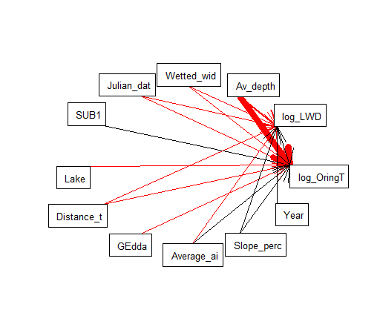
1a) FULL DATASET WITHOUT Nas (n=5263)
fish spp as exogenous and continuous:
Lake and Gedda show negative relationships. marginal R2= 11 and 11
> M2 = list(
+ lme(log_OringTOT~Average_air_temperature+Distance_to_sea+Wetted_width+Av_depth+log_LWD+SUB1+Julian_date+Slope_percent
+ +GEdda+Lake,
+ random=~1|River_name/Catchment_number, corAR1(form=~Year),data=AV2),
+ lme(log_LWD~Average_air_temperature+Distance_to_sea+Av_depth+Wetted_width+Year+Julian_date+Slope_percent,
+ random=~1|River_name/Catchment_number, corAR1(form=~Year),data=AV2))
> sem.fit(M2,AV2)
|===============================================================================================================| 100%
Conditional variables have been omitted from output table for clarity (or use argument conditional = T)
$missing.paths
missing.path estimate std.error df crit.value p.value
1 log_LWD ~ SUB1 + ... -0.0045 0.0132 4073 -0.3387 0.7349
2 log_LWD ~ GEdda + ... -0.0131 0.0110 4073 -1.1876 0.2351
3 log_LWD ~ Lake + ... -0.0062 0.0056 4073 -1.1110 0.2666
4 log_OringTOT ~ Year + ... 0.0038 0.0028 4070 1.3699 0.1708
$Fisher.C
fisher.c df p.value
1 9.69 8 0.287
$AIC
AIC AICc K n
1 63.69 63.979 27 5263
> sem.coefs(M2,AV2)
response predictor estimate std.error p.value
1 log_OringTOT Av_depth -2.104019123 0.1553658557 0.0000 ***
2 log_OringTOT Wetted_width -0.071268825 0.0077064390 0.0000 ***
3 log_OringTOT Julian_date -0.004188240 0.0006583019 0.0000 ***
4 log_OringTOT SUB1 0.101571172 0.0199066129 0.0000 ***
5 log_OringTOT Lake -0.040256787 0.0082705694 0.0000 ***
6 log_OringTOT Distance_to_sea -0.003216887 0.0007022876 0.0000 ***
7 log_OringTOT GEdda -0.075370583 0.0169252705 0.0000 ***
8 log_OringTOT Average_air_temperature 0.096423355 0.0219233320 0.0000 ***
9 log_OringTOT log_LWD 0.085588780 0.0195752458 0.0000 ***
10 log_OringTOT Slope_percent 0.053750129 0.0203756264 0.0084 **
11 log_LWD Wetted_width -0.051306457 0.0045786817 0.0000 ***
12 log_LWD Average_air_temperature -0.086397067 0.0109774258 0.0000 ***
13 log_LWD Year 0.014690672 0.0024931123 0.0000 ***
14 log_LWD Distance_to_sea -0.002011219 0.0003625159 0.0000 ***
15 log_LWD Slope_percent 0.060812149 0.0115345003 0.0000 ***
16 log_LWD Av_depth -0.485894969 0.1048185319 0.0000 ***
17 log_LWD Julian_date -0.001054309 0.0004429863 0.0174 *
> sem.model.fits(M2)
Class Family Link n Marginal Conditional
1 lme gaussian identity 5263 0.1092847 0.8005838
2 lme gaussian identity 5263 0.1139024 0.5128521
Without migrating type
Notes:
# brook trout and grayling (competitiors) as explanatory factors: not signif
# LAxTOT seems to have a weak positive effect on Öring, which does not make sense
# including a correlation between SUB1 and slope doesn't change anything
# including sub as endogenous explained by slope doesn't work smoothly, I d need to addd many other links

Slide 36
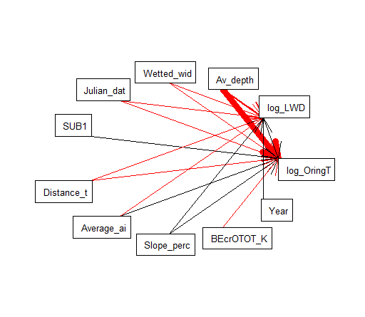
1b) FULL DATASET WITHOUT Nas (n=5263)
using fish spp as exogenous and binary:
brecro have negative effects.Marginal R=10 and 11
M2 = list(
+ lme(log_OringTOT~Average_air_temperature+Distance_to_sea+Wetted_width+Av_depth+log_LWD+SUB1+Julian_date+Slope_percent
+ +BEcrOTOT_KLASS,
+ random=~1|River_name/Catchment_number, corAR1(form=~Year),data=AV2),
+ lme(log_LWD~Average_air_temperature+Distance_to_sea+Av_depth+Wetted_width+Year+Julian_date+Slope_percent,
+ random=~1|River_name/Catchment_number, corAR1(form=~Year),data=AV2))
> sem.fit(M2,AV2)
|===============================================================================================================| 100%
Conditional variables have been omitted from output table for clarity (or use argument conditional = T)
$missing.paths
missing.path estimate std.error df crit.value p.value
1 log_LWD ~ SUB1 + ... -0.0045 0.0132 4073 -0.3387 0.7349
2 log_LWD ~ BEcrOTOT_KLASS + ... 0.2421 0.1356 4073 1.7850 0.0743
3 log_OringTOT ~ Year + ... 0.0041 0.0028 4071 1.4936 0.1354
$Fisher.C
fisher.c df p.value
1 9.81 6 0.133
$AIC
AIC AICc K n
1 61.81 62.078 26 5263
> sem.coefs(M2,AV2)
response predictor estimate std.error p.value
1 log_OringTOT Av_depth -2.058911012 0.1555146063 0.0000 ***
2 log_OringTOT Wetted_width -0.069454643 0.0077366761 0.0000 ***
3 log_OringTOT Julian_date -0.004089055 0.0006595652 0.0000 ***
4 log_OringTOT SUB1 0.101026568 0.0199723736 0.0000 ***
5 log_OringTOT Distance_to_sea -0.003435617 0.0007107319 0.0000 ***
6 log_OringTOT log_LWD 0.090476353 0.0196364831 0.0000 ***
7 log_OringTOT Average_air_temperature 0.091404557 0.0222402459 0.0000 ***
8 log_OringTOT Slope_percent 0.062709745 0.0204950009 0.0022 **
9 log_OringTOT BEcrOTOT_KLASS -0.398442573 0.1977253893 0.0440 *
10 log_LWD Wetted_width -0.051306457 0.0045786817 0.0000 ***
11 log_LWD Average_air_temperature -0.086397067 0.0109774258 0.0000 ***
12 log_LWD Year 0.014690672 0.0024931123 0.0000 ***
13 log_LWD Distance_to_sea -0.002011219 0.0003625159 0.0000 ***
14 log_LWD Slope_percent 0.060812149 0.0115345003 0.0000 ***
15 log_LWD Av_depth -0.485894969 0.1048185319 0.0000 ***
16 log_LWD Julian_date -0.001054309 0.0004429863 0.0174 *
> sem.model.fits(M2)
Class Family Link n Marginal Conditional
1 lme gaussian identity 5263 0.1036911 0.8034928
2 lme gaussian identity 5263 0.1139024 0.5128521
Without migrating type

Slide 37
Older (no slope included, no fish or only gedda included)
But on different datasets as well

Slide 38
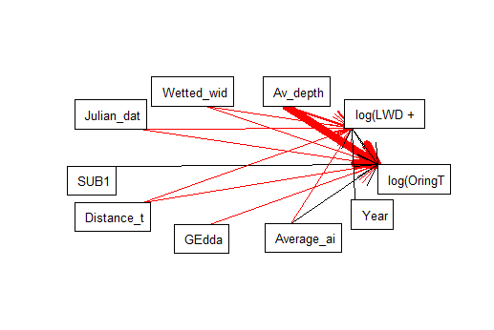
1a) FULL DATASET WITHOUT Nas (n=5263)
> sem.coefs(M2,AV2,standardize = "scale") # not working why? maybe bc oring and lwd is transformed - try to rename it
response predictor estimate std.error p.value
1 log_OringTOT Av_depth -0.14170831 0.009626751 0.0000 ***
2 log_OringTOT Wetted_width -0.16920924 0.017791838 0.0000 ***
3 log_OringTOT Julian_date -0.06261349 0.010404011 0.0000 ***
4 log_OringTOT SUB1 0.06211987 0.012266156 0.0000 ***
5 log_OringTOT Average_air_temperature 0.12746348 0.028883376 0.0000 ***
6 log_OringTOT GEdda -0.03165645 0.007722020 0.0000 ***
7 log_OringTOT log_LWD 0.04637805 0.011982589 0.0001 ***
8 log_OringTOT Distance_to_sea -0.09377822 0.024304858 0.0001 ***
9 log_LWD Wetted_width -0.19717162 0.018905969 0.0000 ***
10 log_LWD Average_air_temperature -0.17961223 0.026532570 0.0000 ***
11 log_LWD Av_depth -0.06075655 0.011204177 0.0000 ***
12 log_LWD Year 0.08253527 0.015966327 0.0000 ***
13 log_LWD Distance_to_sea -0.11621501 0.022771371 0.0000 ***
14 log_LWD Julian_date -0.01776250 0.012069572 0.1412
Warning messages:
1: In if (grepl("cbind", deparse(formula(x)))) all.vars(formula(x))[-c(1:2)] else all.vars(formula(x)) :
the condition has length > 1 and only the first element will be used
2: In if (grepl("cbind", deparse(formula(x)))) all.vars(formula(x))[-c(1:2)] else all.vars(formula(x)) :
the condition has length > 1 and only the first element will be used
> sem.coefs(M2,AV2,standardize = "range")
response predictor estimate std.error p.value
1 log_OringTOT Av_depth -0.30427877 0.021286277 0.0000 ***
2 log_OringTOT Wetted_width -0.47995062 0.049987786 0.0000 ***
3 log_OringTOT Julian_date -0.07234061 0.011291659 0.0000 ***
4 log_OringTOT Average_air_temperature 0.16754643 0.032783368 0.0000 ***
5 log_OringTOT SUB1 0.05877102 0.014143841 0.0000 ***
6 log_OringTOT log_LWD 0.05977465 0.015948674 0.0002 ***
7 log_OringTOT GEdda -0.10584621 0.029522986 0.0003 ***
8 log_OringTOT Distance_to_sea -0.11435454 0.038460517 0.0030 **
9 log_LWD Wetted_width -0.40624084 0.040690093 0.0000 ***
10 log_LWD Average_air_temperature -0.14095954 0.023683372 0.0000 ***
11 log_LWD Av_depth -0.09530435 0.018581505 0.0000 ***
12 log_LWD Year 0.05818450 0.011909835 0.0000 ***
13 log_LWD Distance_to_sea -0.12646103 0.028261691 0.0000 ***
14 log_LWD Julian_date -0.01229635 0.009847569 0.2119
Warning messages:
1: In if (grepl("cbind", deparse(formula(x)))) all.vars(formula(x))[-c(1:2)] else all.vars(formula(x)) :
the condition has length > 1 and only the first element will be used
2: In if (grepl("cbind", deparse(formula(x)))) all.vars(formula(x))[-c(1:2)] else all.vars(formula(x)) :
the condition has length > 1 and only the first element will be used
Old without slopes and fish other than gedda
> M2 = list(
+ lme(log(OringTOT+1)~Average_air_temperature+Distance_to_sea+Wetted_width+Av_depth+log(LWD+1)+SUB1+GEdda+Julian_date,
+ random=~1|River_name/Catchment_number, corAR1(form=~Year),data=AV2),
+ lme(log(LWD+1)~Average_air_temperature+Distance_to_sea+Av_depth+Wetted_width+Year+Julian_date,
+ random=~1|River_name/Catchment_number, corAR1(form=~Year),data=AV2))
> sem.fit(M2,AV2)
|==============================================================================================================| 100%
Conditional variables have been omitted from output table for clarity (or use argument conditional = T)
$missing.paths
missing.path estimate std.error df crit.value p.value
1 log(LWD + 1) ~ SUB1 + ... 0.0011 0.0132 4074 0.0851 0.9322
2 log(LWD + 1) ~ GEdda + ... -0.0167 0.0110 4074 -1.5144 0.1300
3 log(OringTOT + 1) ~ Year + ... 0.0035 0.0027 4072 1.2736 0.2029
$Fisher.C
fisher.c df p.value
1 7.41 6 0.284
$AIC
AIC AICc K n
1 55.41 55.639 24 5263
> sem.coefs(M2,AV2)
response predictor estimate std.error p.value
4 log(OringTOT + 1) Av_depth -2.106714665 0.1553597636 0.0000
3 log(OringTOT + 1) Wetted_width -0.072748606 0.0077037313 0.0000
8 log(OringTOT + 1) Julian_date -0.004113608 0.0006591749 0.0000
6 log(OringTOT + 1) SUB1 0.104686994 0.0198996192 0.0000
2 log(OringTOT + 1) Distance_to_sea -0.003430614 0.0007058658 0.0000
7 log(OringTOT + 1) GEdda -0.079364454 0.0169394461 0.0000
5 log(OringTOT + 1) log(LWD + 1) 0.090051687 0.0195609164 0.0000
1 log(OringTOT + 1) Average_air_temperature 0.088852826 0.0219955689 0.0001
12 log(LWD + 1) Wetted_width -0.053860393 0.0045734869 0.0000
9 log(LWD + 1) Average_air_temperature -0.093366739 0.0110073457 0.0000
13 log(LWD + 1) Year 0.014844441 0.0024975949 0.0000
10 log(LWD + 1) Distance_to_sea -0.002111485 0.0003655278 0.0000
11 log(LWD + 1) Av_depth -0.521459989 0.1047526216 0.0000
14 log(LWD + 1) Julian_date -0.001066235 0.0004439064 0.0164
> sem.model.fits(M2)
Class Family Link N Marginal Conditional
1 lme gaussian identity 5263 0.09986461 0.8014699
2 lme gaussian identity 5263 0.09997273 0.5124213
Standardized coeff
Unstandardized coeff
Notes:
Using month instead of Julian data works as well, slightly lower marginal R2 for Öring
Explore possibility of including slope – and dependency of substrate on it
STANDARDIZE PATH COEFFICIENTS
Once a model was chosen, we compared the relative importance of its predictor variables using standardised path coefficients. We standardised coefficients to the relevant ranges of the component variables as recommended by Grace (2006). A raw coefficient bxy expressing the effect of x on y is range-
standardised as brangexy = bxy 9 (xmax ? xmin)/(ymax ? ymin), where the max and min values represent the largest and small- est values of the variables recorded in the data set (see Fig. S1). This approach produces a dimensionless coefficient that is easily interpretable in the original units. For example a b
value of ?0.349 for effect of grazer richness on microalgal biomass means that microalgal biomass is expected to decline by 35% of its measured range as one moves across the entire measured range of grazer richness, when the influence of other variables is controlled for. Marginal R2 values for endogenous variables were calculated from the best model (model 10) using an approach designed for hierarchical mixed models (Nakagawa & Schielzeth 2013).

Slide 39
Large –scale factors
Temporal variability
Standardized coefficients: variables are scaled by subtracting the minimum and dividing by the difference of the range (black), or by mean and variance (green).
Old without slopes and fish other than gedda
Avg air temp
Julian date
-0.14/-0.18
-0.01/-0.02
distance to sea
0.17/0.13
-0.07/-0.06
-0.11/-0.09
-0.13/-0.12
0.06/0.05
ÖRING
(abund or occurrence)
LWD
-0.41/-0.20
-0.48/-0.17
wetted width
-0.30/-0.14
-0.10/-0.06
-0.11/-0.03
Avg depth
0.06/0.08
0.06/0.06
Pike abundance
SUB1
Year
Small-scale factors
Biotic interactions
Notes:
Woody debris can create pool therefore can potentially affect the depth and maybe the width (Dahlström and Nilsson 2004). Talk to Erik. Maybe wetted width is less liikely to be affected by LWD, if not, exact area should be indipendent. Test: wetted width (or exact area) -> LWD-> depth
LWD: test interaction with predtaors or abiotic such as wetted width (Erik’s graph suggests there may be an interaction)

Slide 40
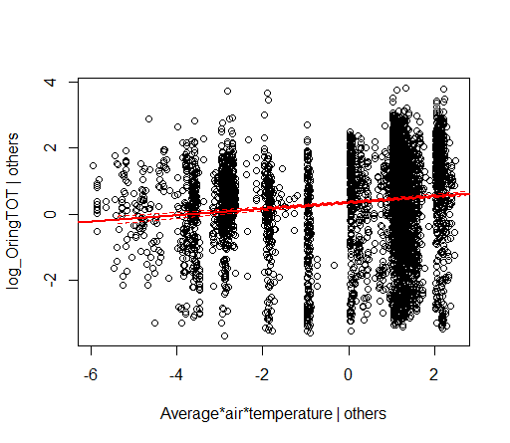
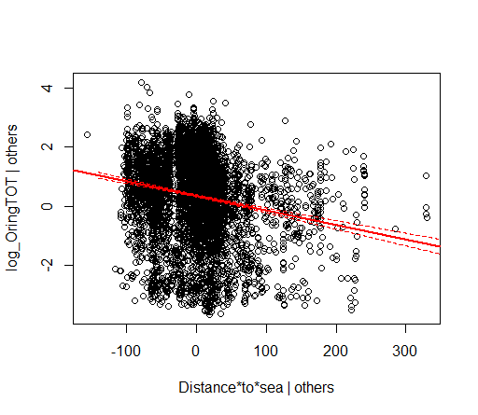
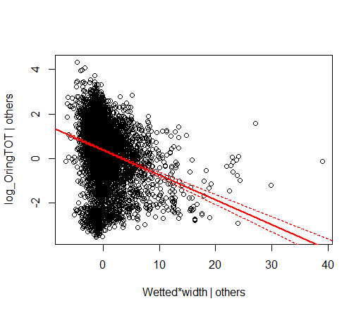
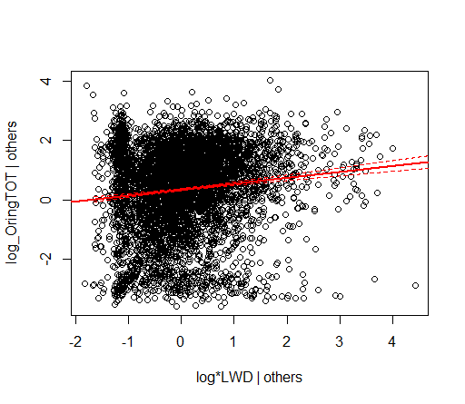
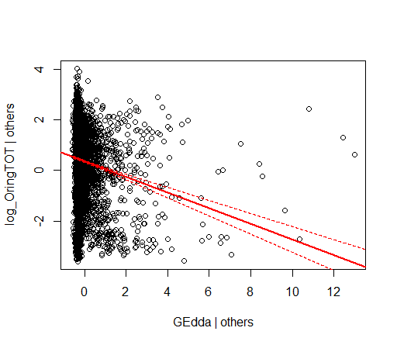
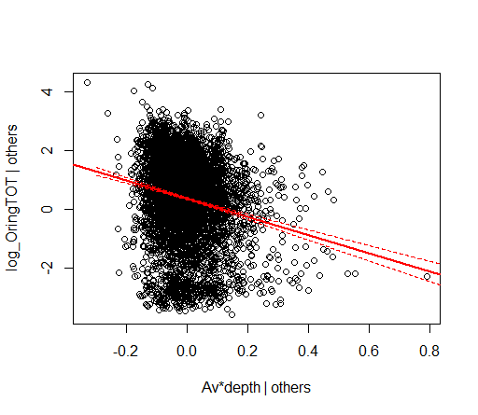
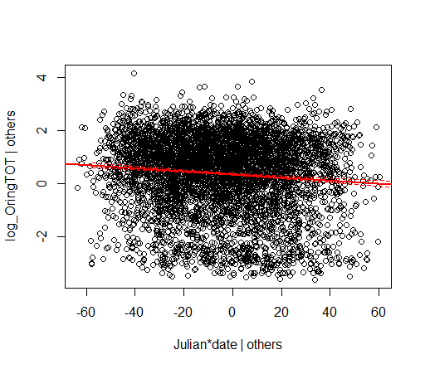
1) FULL DATASET WITHOUT Nas (n=5263)
Partial regression plots for öring:
Old without slopes and fish other than gedda

Slide 41
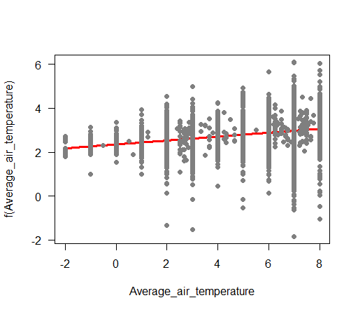
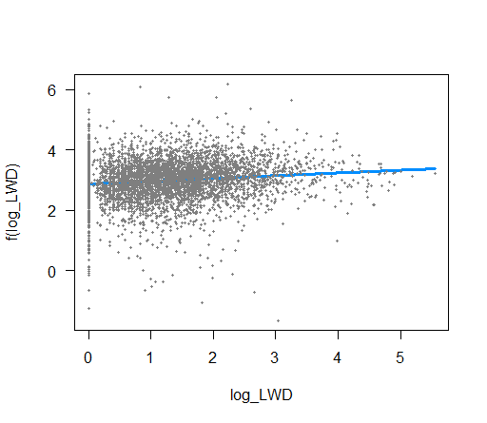
Partial regression plots for öring: using visreg instead of piecewise (I did not draw it for all)
Old without slopes and fish other than gedda

Slide 42
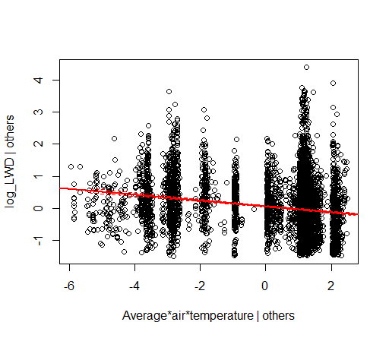
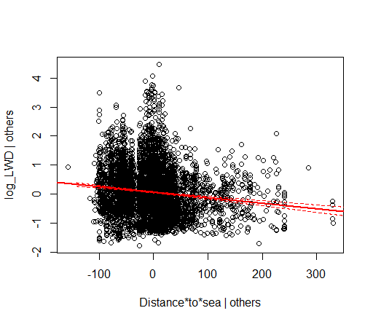
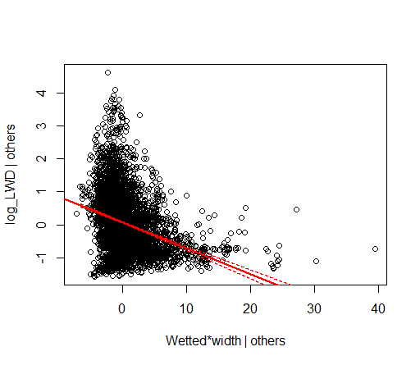
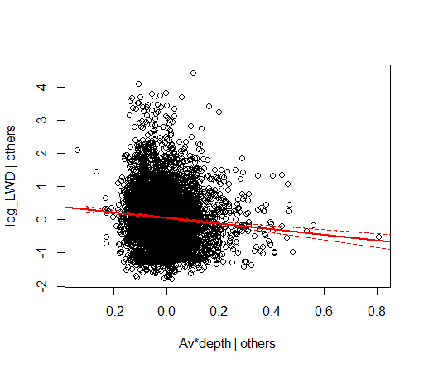
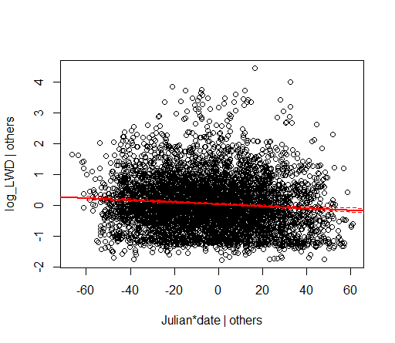
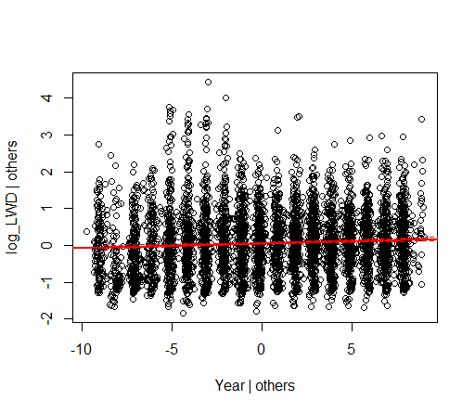
1) FULL DATASET WITHOUT Nas (n=5263)
Partial regression plots for LWD:
Old without slopes and fish other than gedda

Slide 43
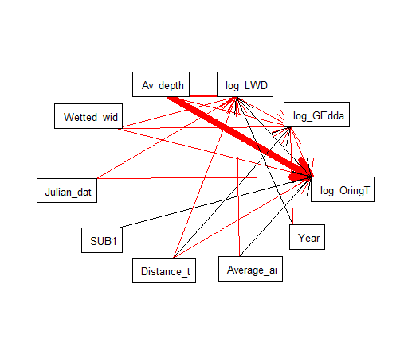
1b) FULL DATASET WITHOUT Nas (n=5263)
using fish spp (only gedda) as endogenous and continuous (logtranformed)
> M2 = list(
+ lme(log_OringTOT~Average_air_temperature+Distance_to_sea+Wetted_width+Av_depth+log_LWD+SUB1+Julian_date+log_GEdda,
+ random=~1|River_name/Catchment_number, corAR1(form=~Year),data=AV2),
+ lme(log_GEdda~Distance_to_sea+Wetted_width+Av_depth+log_LWD+Year,
+ random=~1|River_name/Catchment_number, corAR1(form=~Year),data=AV2),
+ lme(log_LWD~Average_air_temperature+Distance_to_sea+Av_depth+Wetted_width+Year+Julian_date,
+ random=~1|River_name/Catchment_number, corAR1(form=~Year),data=AV2))
> sem.fit(M2,AV2)
|===============================================================================================================| 100%
Conditional variables have been omitted from output table for clarity (or use argument conditional = T)
$missing.paths
missing.path estimate std.error df crit.value p.value
1 log_GEdda ~ Average_air_temperature + ... 0.0073 0.0040 4075 1.8398 0.0659
2 log_LWD ~ SUB1 + ... 0.0011 0.0132 4074 0.0851 0.9322
3 log_GEdda ~ SUB1 + ... -0.0012 0.0059 4075 -0.2022 0.8398
4 log_GEdda ~ Julian_date + ... -0.0001 0.0002 4075 -0.3821 0.7024
5 log_OringTOT ~ Year + ... 0.0033 0.0027 4072 1.2081 0.2271
$Fisher.C
fisher.c df p.value
1 9.6 10 0.476
$AIC
AIC AICc K n
1 77.6 78.055 34 5263
> sem.coefs(M2,AV2)
response predictor estimate std.error p.value
1 log_OringTOT Av_depth -2.119779092 0.1555393975 0.0000 ***
2 log_OringTOT Wetted_width -0.072688507 0.0077000257 0.0000 ***
3 log_OringTOT Julian_date -0.004126966 0.0006594030 0.0000 ***
4 log_OringTOT SUB1 0.105018317 0.0199027430 0.0000 ***
5 log_OringTOT Distance_to_sea -0.003409643 0.0007048032 0.0000 ***
6 log_OringTOT log_GEdda -0.197160249 0.0415055000 0.0000 ***
7 log_OringTOT log_LWD 0.089513039 0.0195753577 0.0000 ***
8 log_OringTOT Average_air_temperature 0.089061705 0.0219550277 0.0001 ***
9 log_GEdda Year -0.003222435 0.0008875819 0.0003 ***
10 log_GEdda log_LWD -0.020772941 0.0060210956 0.0006 ***
11 log_GEdda Wetted_width -0.006170168 0.0018948946 0.0011 **
12 log_GEdda Av_depth -0.128251237 0.0509982908 0.0119 *
13 log_GEdda Distance_to_sea 0.000250321 0.0001262599 0.0475 *
14 log_LWD Wetted_width -0.053860393 0.0045734869 0.0000 ***
15 log_LWD Average_air_temperature -0.093366739 0.0110073457 0.0000 ***
16 log_LWD Year 0.014844441 0.0024975949 0.0000 ***
17 log_LWD Distance_to_sea -0.002111485 0.0003655278 0.0000 ***
18 log_LWD Av_depth -0.521459989 0.1047526216 0.0000 ***
19 log_LWD Julian_date -0.001066235 0.0004439064 0.0164 *
> sem.model.fits(M2)
Class Family Link n Marginal Conditional
1 lme gaussian identity 5263 0.10077102 0.8006190
2 lme gaussian identity 5263 0.01142547 0.3659585
3 lme gaussian identity 5263 0.09997273 0.5124213

Slide 44
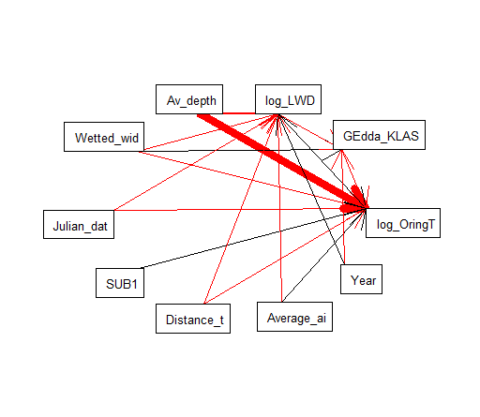
1b) FULL DATASET WITHOUT Nas (n=5263) – pike as endogenous, binary
> M2 = list(
+ lme(log_OringTOT~Average_air_temperature+Distance_to_sea+Wetted_width+Av_depth+log_LWD+SUB1+Julian_date+GEdda_KLASS,
+ random=~1|River_name/Catchment_number, corAR1(form=~Year),data=AV2),
+ lme(GEdda_KLASS~Wetted_width+log_LWD+Year,
+ random=~1|River_name/Catchment_number, corAR1(form=~Year),data=AV2),
+ lme(log_LWD~Average_air_temperature+Distance_to_sea+Av_depth+Wetted_width+Year+Julian_date,
+ random=~1|River_name/Catchment_number, corAR1(form=~Year),data=AV2))
> sem.fit(M2,AV2)
|===============================================================================================================| 100%
Conditional variables have been omitted from output table for clarity (or use argument conditional = T)
$missing.paths
missing.path estimate std.error df crit.value p.value
1 GEdda_KLASS ~ Average_air_temperature + ... 0.0034 0.0042 4077 0.7992 0.4242
2 GEdda_KLASS ~ Distance_to_sea + ... 0.0001 0.0001 4077 0.5705 0.5684
3 GEdda_KLASS ~ Av_depth + ... -0.0944 0.0636 4077 -1.4836 0.1380
4 log_LWD ~ SUB1 + ... 0.0011 0.0132 4074 0.0851 0.9322
5 GEdda_KLASS ~ SUB1 + ... 0.0069 0.0071 4077 0.9710 0.3316
6 GEdda_KLASS ~ Julian_date + ... -0.0003 0.0003 4077 -1.2143 0.2247
7 log_OringTOT ~ Year + ... 0.0036 0.0028 4072 1.3063 0.1915
$Fisher.C
fisher.c df p.value
1 15.45 14 0.348
$AIC
AIC AICc K n
1 79.45 79.854 32 5263
> sem.coefs(M2,AV2)
response predictor estimate std.error p.value
1 log_OringTOT Av_depth -2.093971333 0.1556912573 0.0000 ***
2 log_OringTOT Wetted_width -0.070660981 0.0077122615 0.0000 ***
3 log_OringTOT Julian_date -0.004114361 0.0006602888 0.0000 ***
4 log_OringTOT SUB1 0.105665180 0.0199361135 0.0000 ***
5 log_OringTOT Distance_to_sea -0.003467429 0.0007079482 0.0000 ***
6 log_OringTOT log_LWD 0.091176978 0.0196082256 0.0000 ***
7 log_OringTOT Average_air_temperature 0.088210124 0.0220619130 0.0001 ***
8 log_OringTOT GEdda_KLASS -0.068597365 0.0321624768 0.0330 *
9 GEdda_KLASS Wetted_width 0.010596043 0.0021394413 0.0000 ***
10 GEdda_KLASS Year -0.004316782 0.0011680777 0.0002 ***
11 GEdda_KLASS log_LWD -0.027275161 0.0074147635 0.0002 ***
12 log_LWD Wetted_width -0.053860393 0.0045734869 0.0000 ***
13 log_LWD Average_air_temperature -0.093366739 0.0110073457 0.0000 ***
14 log_LWD Year 0.014844441 0.0024975949 0.0000 ***
15 log_LWD Distance_to_sea -0.002111485 0.0003655278 0.0000 ***
16 log_LWD Av_depth -0.521459989 0.1047526216 0.0000 ***
17 log_LWD Julian_date -0.001066235 0.0004439064 0.0164 *
> sem.model.fits(M2)
Class Family Link n Marginal Conditional
1 lme gaussian identity 5263 0.09818737 0.8013279
2 lme gaussian identity 5263 0.01850252 0.2533444
3 lme gaussian identity 5263 0.09997273 0.5124213

Slide 45
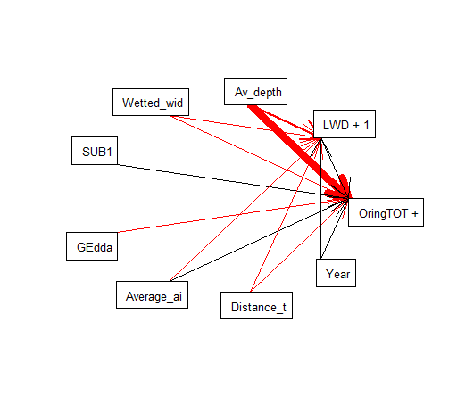
2) On AVOC (excluding rivers that have been sampled only 1 year) without Nas (n=4942)
> M2 = list(
+ lme(log(OringTOT+1)~log(LWD+1)+Av_depth+Wetted_width+Distance_to_sea+Average_air_temperature+SUB1+GEdda+Year,
+ random=~1|River_name/Catchment_number, corAR1(form=~Year),na.action=na.omit, data=AVOC),
+ lme(log(LWD+1)~Distance_to_sea+Average_air_temperature+Av_depth+Wetted_width+Year,
+ random=~1|River_name/Catchment_number, corAR1(form=~Year),na.action=na.omit, data=AVOC))
> sem.fit(M2,AVOC)
|===============================================================================================================| 100%
Conditional variables have been omitted from output table for clarity (or use argument conditional = T)
$missing.paths
missing.path estimate std.error df crit.value p.value
1 log(LWD+1) ~ SUB1 + ... -0.0009 0.0122 5318 -0.0714 0.9431
2 log(LWD+1) ~ GEdda + ... -0.0011 0.0091 5319 -0.1185 0.9057
$Fisher.C
fisher.c df p.value
1 0.32 4 0.989
$AIC
AIC AICc K n
1 46.32 46.497 23 6269
> sem.coefs(M2,AVOC)
response predictor estimate std.error p.value
1 log(OringTOT + 1) Av_depth -2.057402647 0.1377434696 0.0000 ***
2 log(OringTOT + 1) Wetted_width -0.077376786 0.0068632123 0.0000 ***
3 log(OringTOT + 1) log(LWD + 1) 0.100691172 0.0182716077 0.0000 ***
4 log(OringTOT + 1) SUB1 0.082798505 0.0184212472 0.0000 ***
5 log(OringTOT + 1) GEdda -0.056961624 0.0139618628 0.0000 ***
6 log(OringTOT + 1) Average_air_temperature 0.088816113 0.0223717767 0.0001 ***
7 log(OringTOT + 1) Distance_to_sea -0.001840282 0.0007325232 0.0120 *
8 log(OringTOT + 1) Year 0.005731089 0.0025765763 0.0262 *
9 log(LWD + 1) Wetted_width -0.050528448 0.0041171600 0.0000 ***
10 log(LWD + 1) Average_air_temperature -0.096352958 0.0109143951 0.0000 ***
11 log(LWD + 1) Distance_to_sea -0.002429383 0.0003725618 0.0000 ***
12 log(LWD + 1) Year 0.013421089 0.0023281846 0.0000 ***
13 log(LWD + 1) Av_depth -0.490579777 0.0909760375 0.0000 ***
> sem.model.fits(M2)
Class Family Link n Marginal Conditional
1 lme gaussian identity 6269 0.1056071 0.7706319
2 lme gaussian identity 6270 0.1026018 0.4882388
Notes:
# include interaction predators*LWD: not signif

Slide 46
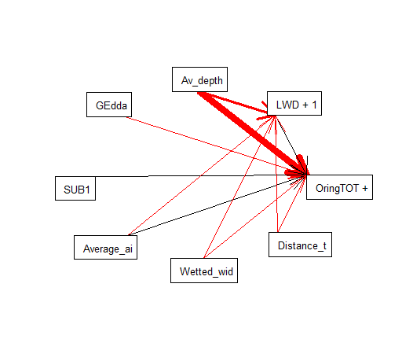
3) Taking away temporal variability: AVyear (averages of years) without NAs: (n=646)
> M2 = list(
+ lme(log(OringTOT+1)~log(LWD+1)+Av_depth+Wetted_width+Distance_to_sea+Average_air_temperature+SUB1+GEdda,
+ random=~1|River_name/Catchment_number, na.action=na.omit, data=AVyear),
+ lme(log(LWD+1)~Distance_to_sea+Average_air_temperature+Av_depth+Wetted_width,
+ random=~1|River_name/Catchment_number, na.action=na.omit, data=AVyear))
> sem.fit(M2,AVyear)
|===============================================================================================================| 100%
Conditional variables have been omitted from output table for clarity (or use argument conditional = T)
$missing.paths
missing.path estimate std.error df crit.value p.value
1 log(LWD+1) ~ SUB1 + ... -0.0484 0.0236 47 -2.0483 0.0461 *
2 log(LWD+1) ~ GEdda + ... -0.0276 0.0308 47 -0.8977 0.3739
$Fisher.C
fisher.c df p.value
1 8.12 4 0.087
$AIC
AIC AICc K n
1 46.12 46.735 19 1256
> sem.coefs(M2,AVyear)
response predictor estimate std.error p.value
1 log(OringTOT + 1) Av_depth -3.422938541 0.5254164026 0.0000 ***
2 log(OringTOT + 1) GEdda -0.325694931 0.0612871013 0.0000 ***
3 log(OringTOT + 1) SUB1 0.242916263 0.0474041212 0.0000 ***
4 log(OringTOT + 1) Average_air_temperature 0.101391275 0.0244501709 0.0001 ***
5 log(OringTOT + 1) Wetted_width -0.055303072 0.0154773054 0.0009 ***
6 log(OringTOT + 1) Distance_to_sea -0.002701460 0.0007955705 0.0014 **
7 log(OringTOT + 1) log(LWD + 1) 0.156070991 0.0566122032 0.0084 **
8 log(LWD + 1) Wetted_width -0.073456445 0.0071558237 0.0000 ***
9 log(LWD + 1) Average_air_temperature -0.089024443 0.0117326609 0.0000 ***
10 log(LWD + 1) Distance_to_sea -0.002076086 0.0003917038 0.0000 ***
11 log(LWD + 1) Av_depth -1.359471194 0.2574130279 0.0000 ***
> sem.model.fits(M2)
Class Family Link n Marginal Conditional
1 lme gaussian identity 1256 0.2236359 0.9563053
2 lme gaussian identity 1257 0.2061357 0.9999960

Slide 47
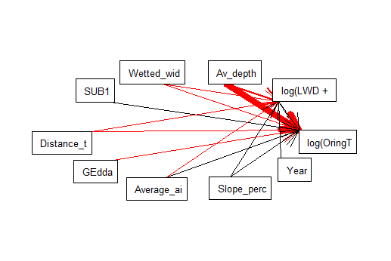
> M2 = list(
+ lme(log(OringTOT+1)~Average_air_temperature+Distance_to_sea+Wetted_width+Av_depth+log(LWD+1)+Slope_percent+SUB1+GEdda,
+ random=~1|River_name/Catchment_number, corAR1(form=~Year),data=AV2),
+ lme(log(LWD+1)~Average_air_temperature+Distance_to_sea+Av_depth+Wetted_width+Year+Slope_percent,
+ random=~1|River_name/Catchment_number, corAR1(form=~Year),data=AV2))
> sem.fit(M2,AV2)
|==============================================================================================================| 100%
Conditional variables have been omitted from output table for clarity (or use argument conditional = T)
$missing.paths
missing.path estimate std.error df crit.value p.value
1 log(LWD + 1) ~ SUB1 + ... -0.0033 0.0132 4074 -0.2515 0.8014
2 log(LWD + 1) ~ GEdda + ... -0.0130 0.0110 4074 -1.1819 0.2373
3 log(OringTOT + 1) ~ Year + ... 0.0051 0.0027 4072 1.8605 0.0629
$Fisher.C
fisher.c df p.value
1 8.85 6 0.182
$AIC
AIC AICc K n
1 56.85 57.079 24 5263
> sem.coefs(M2,AV2)
response predictor estimate std.error p.value
4 log(OringTOT + 1) Av_depth -2.151537045 0.1556548534 0.0000
3 log(OringTOT + 1) Wetted_width -0.070365969 0.0077560392 0.0000
7 log(OringTOT + 1) SUB1 0.104541756 0.0199989323 0.0000
2 log(OringTOT + 1) Distance_to_sea -0.003283858 0.0007090272 0.0000
5 log(OringTOT + 1) log(LWD + 1) 0.090353169 0.0196479373 0.0000
8 log(OringTOT + 1) GEdda -0.075745838 0.0170110027 0.0000
1 log(OringTOT + 1) Average_air_temperature 0.087212710 0.0221248570 0.0001
6 log(OringTOT + 1) Slope_percent 0.057848536 0.0205260836 0.0049
12 log(LWD + 1) Wetted_width -0.051088874 0.0045860759 0.0000
9 log(LWD + 1) Average_air_temperature -0.088521418 0.0109813921 0.0000
13 log(LWD + 1) Year 0.015004313 0.0024903165 0.0000
10 log(LWD + 1) Distance_to_sea -0.002001481 0.0003637716 0.0000
14 log(LWD + 1) Slope_percent 0.061086977 0.0115639868 0.0000
11 log(LWD + 1) Av_depth -0.506157091 0.1044539289 0.0000
> sem.model.fits(M2)
Class Family Link N Marginal Conditional
1 lme gaussian identity 5263 0.1024969 0.8018843
2 lme gaussian identity 5263 0.1118796 0.5148663
Slope has been added. Support for both (positive) links??
I go on without meanwhile..
EXCLUDING NAs
Notes:
If I add slope, account for possible dependence between slope and substarte

Slide 48
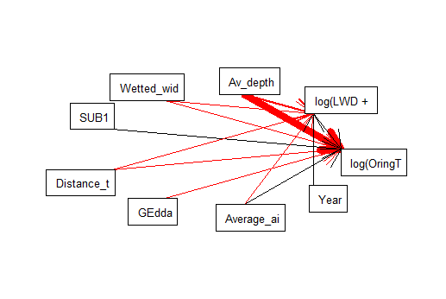
> M2 = list(
+ lme(log(OringTOT+1)~log(LWD+1)+Av_depth+Wetted_width+Distance_to_sea+Average_air_temperature+SUB1+GEdda,
+ random=~1|River_name/Catchment_number, corAR1(form=~Year),data=AV2),
+ lme(log(LWD+1)~Distance_to_sea+Average_air_temperature+Av_depth+Wetted_width+Year,
+ random=~1|River_name/Catchment_number, corAR1(form=~Year),data=AV2))
> sem.fit(M2,AV2)
|==============================================================================================================| 100%
Conditional variables have been omitted from output table for clarity (or use argument conditional = T)
$missing.paths
missing.path estimate std.error df crit.value p.value
1 log(LWD + 1) ~ SUB1 + ... 0.0023 0.0132 4075 0.1726 0.8630
2 log(LWD + 1) ~ GEdda + ... -0.0166 0.0110 4075 -1.5085 0.1315
3 log(OringTOT + 1) ~ Year + ... 0.0050 0.0027 4073 1.8350 0.0666
$Fisher.C
fisher.c df p.value
1 9.77 6 0.135
$AIC
AIC AICc K n
1 53.77 53.963 22 5263
> sem.coefs(M2,AV2)
response predictor estimate std.error p.value
2 log(OringTOT + 1) Av_depth -2.175563985 0.1555555370 0e+00
3 log(OringTOT + 1) Wetted_width -0.072270102 0.0077301974 0e+00
6 log(OringTOT + 1) SUB1 0.108400432 0.0199657725 0e+00
4 log(OringTOT + 1) Distance_to_sea -0.003387130 0.0007079608 0e+00
1 log(OringTOT + 1) log(LWD + 1) 0.093209435 0.0196335787 0e+00
7 log(OringTOT + 1) GEdda -0.078657484 0.0169988672 0e+00
5 log(OringTOT + 1) Average_air_temperature 0.081597394 0.0220290488 2e-04
11 log(LWD + 1) Wetted_width -0.053638484 0.0045812919 0e+00
9 log(LWD + 1) Average_air_temperature -0.095535325 0.0110119517 0e+00
12 log(LWD + 1) Year 0.015163769 0.0024948585 0e+00
8 log(LWD + 1) Distance_to_sea -0.002102436 0.0003668393 0e+00
10 log(LWD + 1) Av_depth -0.541866923 0.1043790679 0e+00
> sem.model.fits(M2)
Class Family Link N Marginal Conditional
1 lme gaussian identity 5263 0.0970524 0.8003521
2 lme gaussian identity 5263 0.0979510 0.5145529
Öring continuous
EXCLUDING NAs
Notes:
Full dataset does not work as there are too many NAs.
Playing with predictors:
CIMATIC: when avg air temp is replaced with lat in both repsonse variable models, results are very similar (only slightly different R2, see next slide). With altitude instead, fit is worse.
STREAM SIZE: exakt area is not significant when including wetted widht and avg depth. When using max depth instead of avg depth, max depth only explain öring but not LWD and R squared are slightly lower.
LOCAL FEATURES: velocity for LWD: not signif. Slope_percent for LWD: yes, but also a link to Öring is suggested, links are positive in both cases, R2 are higher, but are the links supported by theory?
SEASONALITY: month or Julian date are signif for both responses, R2 increase (more with Julian date)
BIOTIC INTERACTIONS: GEdda+Lampetra+Sticklebacks+LaxTOT+Abbor+Lake+Cottus_spp were signif (see below), but overall fit not good
# talk to Erik to know what makes sense. For now I keep only Gedda
> sem.coefs(M2,AV2)
response predictor estimate std.error p.value
4 log(OringTOT + 1) Av_depth -2.055590693 0.1554829375 0.0000
3 log(OringTOT + 1) Wetted_width -0.073083904 0.0076255206 0.0000
14 log(OringTOT + 1) Cottus_spp 0.003920483 0.0006336577 0.0000
7 log(OringTOT + 1) Julian_date -0.004058484 0.0006592314 0.0000
13 log(OringTOT + 1) Lake -0.044322901 0.0082402212 0.0000
6 log(OringTOT + 1) SUB1 0.100477837 0.0197948401 0.0000
8 log(OringTOT + 1) GEdda -0.080355621 0.0168033968 0.0000
1 log(OringTOT + 1) Average_air_temperature 0.102528677 0.0215576316 0.0000
2 log(OringTOT + 1) Distance_to_sea -0.003140073 0.0006913931 0.0000
5 log(OringTOT + 1) log(LWD + 1) 0.085107344 0.0195263661 0.0000
10 log(OringTOT + 1) Sticklebacks -0.003169144 0.0007614131 0.0000
12 log(OringTOT + 1) Abbor -0.011688403 0.0036358854 0.0013
9 log(OringTOT + 1) Lampetra 0.004391320 0.0015543489 0.0047
11 log(OringTOT + 1) LaxTOT 0.001755352 0.0007746250 0.0235
18 log(LWD + 1) Wetted_width -0.053860393 0.0045734869 0.0000
15 log(LWD + 1) Average_air_temperature -0.093366739 0.0110073457 0.0000
19 log(LWD + 1) Year 0.014844441 0.0024975949 0.0000
16 log(LWD + 1) Distance_to_sea -0.002111485 0.0003655278 0.0000
17 log(LWD + 1) Av_depth -0.521459989 0.1047526216 0.0000
20 log(LWD + 1) Julian_date -0.001066235 0.0004439064 0.0164

Slide 49
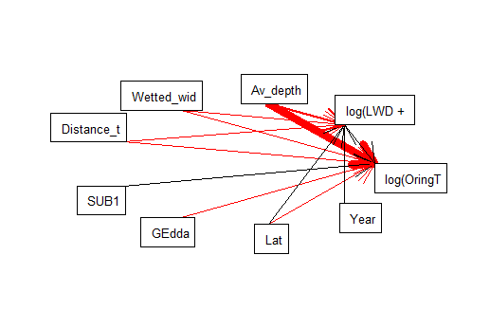
M2 = list(
+ lme(log(OringTOT+1)~Lat+Distance_to_sea+Wetted_width+Av_depth+log(LWD+1)+SUB1+GEdda,
+ random=~1|River_name/Catchment_number, corAR1(form=~Year),data=AV2),
+ lme(log(LWD+1)~Distance_to_sea+Lat+Av_depth+Wetted_width+Year,
+ random=~1|River_name/Catchment_number, corAR1(form=~Year),data=AV2))
> sem.fit(M2,AV2)
|==============================================================================================================| 100%
Conditional variables have been omitted from output table for clarity (or use argument conditional = T)
$missing.paths
missing.path estimate std.error df crit.value p.value
1 log(LWD + 1) ~ SUB1 + ... 0.0034 0.0132 4075 0.2575 0.7968
2 log(LWD + 1) ~ GEdda + ... -0.0154 0.0110 4075 -1.4005 0.1614
3 log(OringTOT + 1) ~ Year + ... 0.0051 0.0027 4073 1.8614 0.0628
$Fisher.C
fisher.c df p.value
1 9.64 6 0.141
$AIC
AIC AICc K n
1 53.64 53.833 22 5263
> sem.coefs(M2,AV2)
response predictor estimate std.error p.value
4 log(OringTOT + 1) Av_depth -2.177356947 0.1555823428 0e+00
3 log(OringTOT + 1) Wetted_width -0.072667097 0.0077287742 0e+00
2 log(OringTOT + 1) Distance_to_sea -0.003738785 0.0006818281 0e+00
6 log(OringTOT + 1) SUB1 0.107306114 0.0199565395 0e+00
5 log(OringTOT + 1) log(LWD + 1) 0.092985531 0.0196436241 0e+00
7 log(OringTOT + 1) GEdda -0.079281020 0.0170031468 0e+00
1 log(OringTOT + 1) Lat -0.050594068 0.0147669570 6e-04
11 log(LWD + 1) Wetted_width -0.053428568 0.0045695549 0e+00
9 log(LWD + 1) Lat 0.065436918 0.0073224292 0e+00
12 log(LWD + 1) Year 0.014959421 0.0024947004 0e+00
10 log(LWD + 1) Av_depth -0.537123117 0.1043543168 0e+00
8 log(LWD + 1) Distance_to_sea -0.001774232 0.0003540409 0e+00
> sem.model.fits(M2)
Class Family Link N Marginal Conditional
1 lme gaussian identity 5263 0.09539722 0.8000731
2 lme gaussian identity 5263 0.10236969 0.5158832
> sem.plot(M2, AV)
Öring continuous
With Lat instead of avg air temp
EXCLUDING NAs

Slide 50
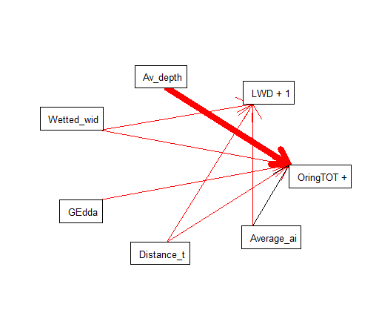
> M2 = list(
+ lme(log(OringTOT+1)~Av_depth+Wetted_width+Distance_to_sea+Average_air_temperature+GEdda,
+ random=~1|River_name/Catchment_number, na.action=na.omit, data=AV2009),
+ lme(log(LWD+1)~Distance_to_sea+Average_air_temperature+Wetted_width,
+ random=~1|River_name/Catchment_number, na.action=na.omit, data=AV2009))
> sem.fit(M2,AV2009)
|===============================================================================================================| 100%
Conditional variables have been omitted from output table for clarity (or use argument conditional = T)
$missing.paths
missing.path estimate std.error df crit.value p.value
1 log(LWD+1) ~ Av_depth + ... -0.5517 0.4770 7 -1.1567 0.2853
2 log(LWD+1) ~ GEdda + ... -0.0748 0.0650 7 -1.1494 0.2881
3 log(LWD+1) ~ OringTOT + ... -0.0007 0.0005 5 -1.4073 0.2184
$Fisher.C
fisher.c df p.value
1 8.04 6 0.235
$AIC
AIC AICc K n
1 40.04 41.332 16 438
> sem.coefs(M2,AV2009)
response predictor estimate std.error p.value
1 log(OringTOT + 1) Av_depth -3.870818728 0.8145682414 0.0032 **
2 log(OringTOT + 1) Wetted_width -0.090854325 0.0205231249 0.0044 **
3 log(OringTOT + 1) GEdda -0.469018569 0.1107853712 0.0055 **
4 log(OringTOT + 1) Distance_to_sea -0.005917272 0.0014140527 0.0058 **
5 log(OringTOT + 1) Average_air_temperature 0.093498407 0.0345083938 0.0351 *
6 log(LWD + 1) Wetted_width -0.091465079 0.0109423106 0.0000 ***
7 log(LWD + 1) Average_air_temperature -0.083567487 0.0202341710 0.0033 **
8 log(LWD + 1) Distance_to_sea -0.002057808 0.0008322442 0.0386 *
> sem.model.fits(M2)
Class Family Link n Marginal Conditional
1 lme gaussian identity 438 0.2779934 0.9999724
2 lme gaussian identity 439 0.2063915 0.9999610
taking away temporal variability:
# With AV2009 without NAs:

Slide 51
BINARY

Slide 52
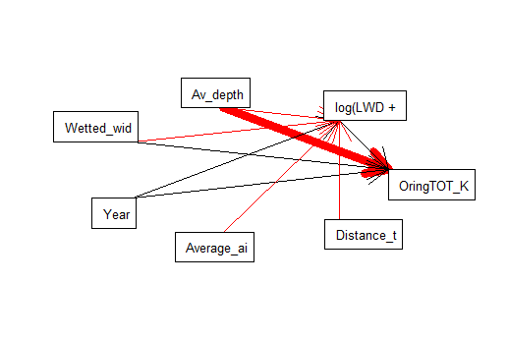
> M2 = list(
+ glmer(OringTOT_KLASS~log(LWD+1)+Av_depth+Wetted_width+Year
+ +(1|Catchment_number/River_name),family=binomial,data=AV2),
+ lme(log(LWD+1)~Distance_to_sea+Average_air_temperature+Av_depth+Wetted_width+Year,
+ random=~1|River_name/Catchment_number, corAR1(form=~Year),data=AV2))
Warning messages:
1: In checkConv(attr(opt, "derivs"), opt$par, ctrl = control$checkConv, :
Model failed to converge with max|grad| = 0.837533 (tol = 0.001, component 1)
2: In checkConv(attr(opt, "derivs"), opt$par, ctrl = control$checkConv, :
Model is nearly unidentifiable: very large eigenvalue
- Rescale variables?;Model is nearly unidentifiable: large eigenvalue ratio
- Rescale variables?
> sem.fit(M2,AV2)
|==============================================================================================================| 100%
Conditional variables have been omitted from output table for clarity (or use argument conditional = T)
$missing.paths
missing.path estimate std.error df crit.value p.value
1 OringTOT_KLASS ~ Distance_to_sea + ... -0.0057 0.0032 NA -1.7518 0.0798
2 OringTOT_KLASS ~ Average_air_temperature + ... 0.0886 0.1053 NA 0.8419 0.3998
$Fisher.C
fisher.c df p.value
1 6.89 4 0.142
$AIC
AIC AICc K n
1 40.89 41.007 17 5263
> sem.coefs(M2,AV2)
response predictor estimate std.error p.value
2 OringTOT_KLASS Av_depth -4.822304071 1.1593256133 0.0000
3 OringTOT_KLASS Wetted_width 0.153714210 0.0555047735 0.0056
1 OringTOT_KLASS log(LWD + 1) 0.439002754 0.1603767704 0.0062
4 OringTOT_KLASS Year 0.012105996 0.0051706757 0.0192
8 log(LWD + 1) Wetted_width -0.053638484 0.0045812919 0.0000
6 log(LWD + 1) Average_air_temperature -0.095535325 0.0110119517 0.0000
9 log(LWD + 1) Year 0.015163769 0.0024948585 0.0000
5 log(LWD + 1) Distance_to_sea -0.002102436 0.0003668393 0.0000
7 log(LWD + 1) Av_depth -0.541866923 0.1043790679 0.0000
> sem.model.fits(M2)
Class Family Link N Marginal Conditional
1 glmerMod binomial logit 5263 0.002319134 0.9832784
2 lme gaussian identity 5263 0.097951003 0.5145529
Öring binary on reduced dataset (no Nas)
Besides warning msg, one problem is that I could not model temp correlation for öring
Marginal R2 very low, conditionla very high: presence absence is explained almost fully by river
Notes:
On full dataset: Nas give problems, hard to converge, takes forever
On dataset without Nas: see above. But still I did not model temporal correlation (see above). I triued transforming some predictors to reduce spread:
On data with averages of years: NAs give problems. When removing them: LWD becomes almost but not significant for trout
On data from 1 specific year, i.e. 2009: Nas give problems. When removing them: no converge

Slide 53
BINARY RESPONSE: Reconsider model with presence/absence
check order for script of random factor (done, ok)
exclude those river sampled only 1 year (AVOC) and retry modelling temp corr: nope. It runs with lme so the problem is glmer
choose 1 year , 2009 is the one with more observations (AV2009, n=1092) - done
take average from all years (AVyear, n= ca 4000) - done
I go on with continuous…
Consider transformation of predictors
Consider interaction LWD and predators
Consider inclusion of missing factors: vegetation, land use, water discharge, presence of dams
Check out VIX
Exclude NAs more selectively, to have larger dataset
Remember also to say something about possible sampling artifacts: no issues detected

